Slide 1




Pasos Para Prevenir Cancer
Choose My Plate
Notes:
We started our classes by introducing you all to Pasos Para Prevenir Cancer. Our program’ goal is to educate the public on the 13 different types of cancers that are associated to overweight and obesity. The two previous subjects that we discussed were how obesity is linked to cancer and how a person’s weight status can be determined using BMI and waist circumference. In this session, we will focus on Choose MyPlate, which is used as a reminder to find your healthy eating style and build on it throughout your lifetime.

Slide 2
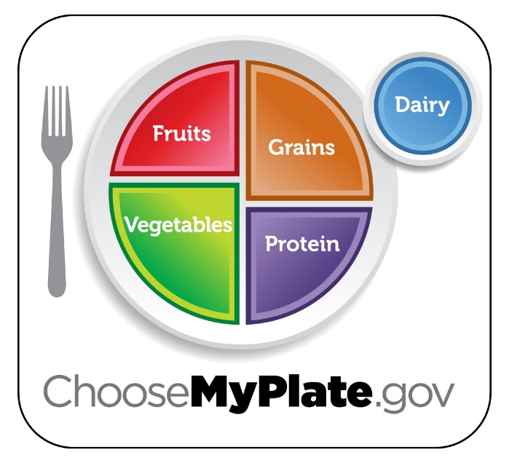
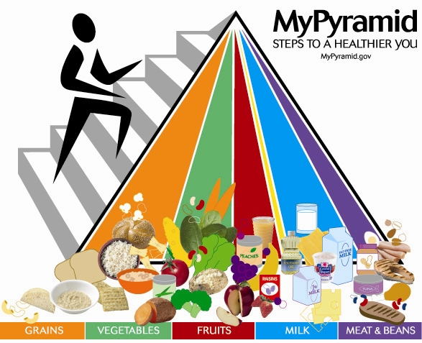
What is Choose MyPlate.
MyPlate is the current nutrition guide published by the USDA Center for Nutrition Policy and Promotion.
It replaced the USDA's MyPyramid guide.
Notes:
The U.S Department of Agriculture, better known as the USDA, created My Plate as an easy-to-follow food guide, to help people figure out how to eat nutritious, balanced meals. It was created to replace the old My Food Pyramid that was used for almost 20 years. MyPlate is the current nutrition guide published by the USDA Center for Nutrition Policy and Promotion, it resembles a food circle depicting a place setting with a plate and a glass divided into five food groups and is based on the recommendations of the Dietary Guidelines for Americans. The plate includes sections for vegetables, fruits, grains, foods high in protein, and dairy products. The new design was created to help grab consumers’ attention with a new visual cue and made it easier to follow because it centers on filling half your plate with fruits and vegetables. It also establishes rules that limit added sugars and solid fats in the diet, and slashed the maximum recommendation for sodium from less than 2,300 mg to 1,500 mg per day. Documents from the new dietary guidelines mention that most Americans consume too few fruits and vegetables and too many added sugars and solid fats. The old Food Pyramid received a lot of criticism because it was very complex to follow. It placed foods that made up the largest portions of a recommended diet such as grains, fruits and vegetables at its base and foods that would be eaten less often like meat, dairy, fat, and sugar at the narrow top. This design is not effective for Americans because our method of eating follows a reversed pattern. Other problems with the Food Pyramid were that it requested that people eat a specific number of servings, it did not distinguish between healthy foods like brown rice or fish and less healthy foods like white rice or sausage. The new plate design is a better representation of how people truly eat when using a plate. It is even useful for people who choose not to consume or limit their meat choices like vegetarians or vegans. My Plate is a program focused on informing the general public about solutions to real nutritional problems to achieve their goals of eating a healthier diet. It provides information and strategies based on culture and people's preferences. The goal of my plate is to foster healthier living while creating permanent changes in eating habits for all people. The next slide will elaborate on how MyPlate is used.

Slide 3
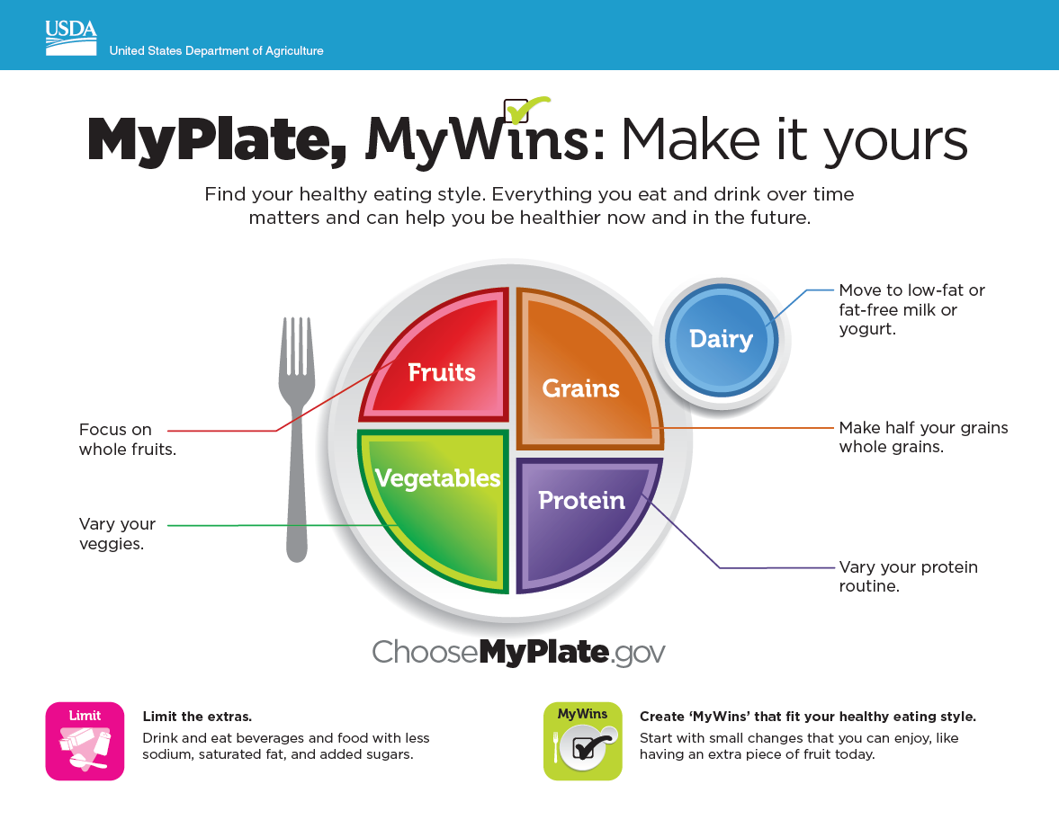
Notes:
As we mentioned in the previous slide, the plate is divided into four unequal sections to represent different food groups. Vegetables make up the largest section, followed by grains. Fruits and vegetables fill half the plate while proteins and grains fill the other half. One of the key differences between the old Food Pyramid and MyPlate is that MyPlate does not have a meats and beans section. Instead, it provides a section for protein, which would include items like fish, shellfish, eggs, beans, peas, nuts, and seeds in addition to meat. Another noticeable things is that MyPlate has eliminated the oils or fats section that were in the food pyramid. The small blue circle on the upper right represents dairy. This simple model is designed to make it easy for consumers to see what an ideal meal should look like, without too many restrictive details. What we eat matters and eating healthy can help us be healthier now and in the future. This is made possible by eating a variety of meals within the MyPlate guideline. The best meals have a balance of items from different food groups. Some great suggestions are to fill half your plate with vegetables and fruits, make at least half the grains you serve whole grains, like oatmeal, whole-wheat bread, and brown rice, serve fat-free or low-fat milk and water rather than sugary drinks, and do not serve oversized portions. In a future class we will discuss limiting the extra items added to food like condiments, sodium, saturated fat, and added sugars. One of the most important notes is that it is recommend that people who start using MyPlate start with small changes.

Slide 4
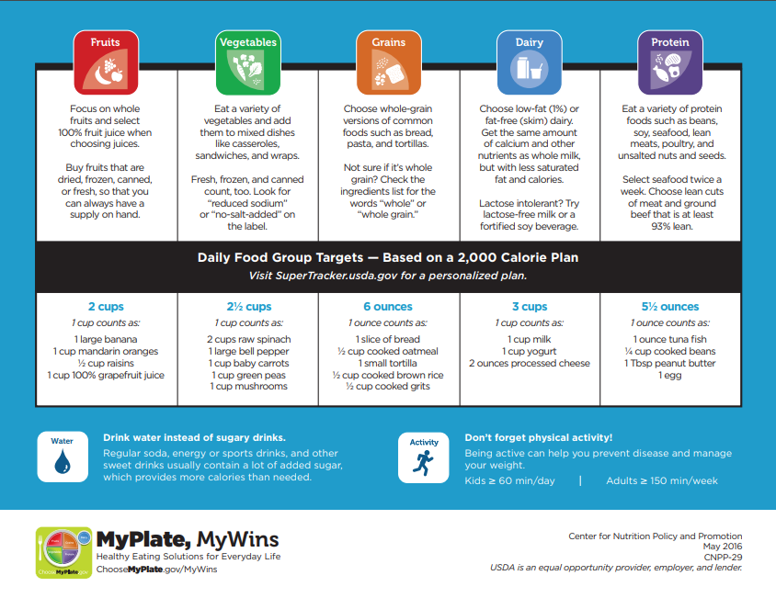
Notes:
So now that we know what the different food groups in MyPlate are, we can now focus on how to break down each individual group. When selecting fruits to eat, it is best that we focus on consuming whole fruits and only drink juices that are made with 100% fruit juice. The recommended daily intake of fruits are 2 cups per day, based on a 2,000 calorie diet. Eating a variety of vegetables is also highly recommended. This can be done by adding vegetables to mixed dishes, casseroles, sandwiches, and wraps. The recommended daily intake of vegetables is 2 and a half cups of vegetables a day. One common misconception is that canned vegetables are not good for you. This is a myth! Eating canned vegetables is recommended, as long as we try to focus on getting canned vegetables that are labeled reduced sodium or no-salt added. The whole-grain version of breads, pastas, and tortillas are the best way to go when selecting grains to eat. The recommended daily intake for grains is 6 ounces which equates to about six slices of bread, 6 small tortillas, or a half cup of cooked brown rice. We already mentioned in the previous slide that it is best to select low-fat or fat-free milk when selecting dairy products to drink. Both of these products offer the same nutritional value as whole milk, however, they remove the saturated fat and calories. The recommended daily intake for dairy products is about 3 cups a day. A great example of how to consume three cups in one day is by drinking 1 cup of milk, eating one cup of yogurt, and by eating 2 ounces of processed cheese. Protein is abundant in many types of food, including some plants. When selecting meats, it is important to select lean cuts of meat and ground beef that is at last 93 percent lean. Foods like beans, soy, unsalted nuts, and seeds also offer a lot of protein and should be included in our meals. Eating seafood twice a week is a recommended practice for those who choose to get protein from animal sources. In the next few slides we will instruct ways to use these guidelines to create healthier meals.

Slide 5
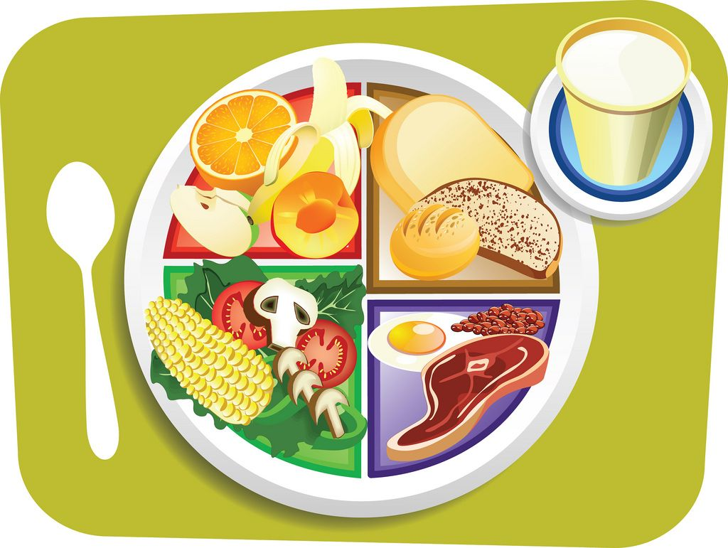
Tips to Build a Healthy Meal
Make half your plate veggies and fruits.
Vary your veggies
Make half your grains whole grains
Move to low-fat or fat-free milk or yogurt
Vary your protein routine
Drink Water
(El Departamento de Agricultura de los Estados Unidos , USDA)
Notes:
The MyPlate design was created as a template on how a plate should look like when we eat from it. The glory about this design, is that it saves us from having to measure and calculate every ounce of food that we consume. Instead, we use the recommended daily intake for each food group that we discussed on the last slide, and we simply insert a fraction of that into every meal that we consume. Here is why those recommendation have been made. Fruits and vegetables not only add fiber and important nutrients to our diet, but they also add flavors, colors, and textures. People who include fruits and vegetables in their daily diet are believed to be less at risk for chronic disease. Grains are important sources of essential nutrients such as magnesium, zinc, B vitamins, and fiber. Dairy provides calcium, vitamin D, potassium, protein, and other essential nutrients for good daily health. Animal-based protein foods like eggs, dairy, seafood, meat and one plant-based protein, which is soy, provides all nine essential amino acids needed in the body. Other plant based foods offer smaller amounts of protein so they should be eaten in variety to account for all the protein needed by the body on a daily basis. We mentioned earlier that we should consume foods and beverages that offer less sodium, saturated fat, and added sugars. The best way to drink wholesome products is by simply drinking water instead of sugary drinks. The next few slides will inform you on the benefits of each section of the My Plate guide.

Slide 6
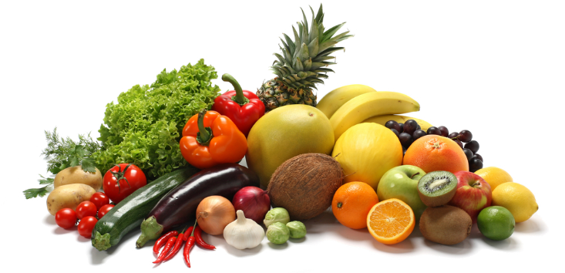
Make Half Plate Fruits and Vegetables
Add more vegetables to your day
Discover fast ways to cook
Choose vegetables rich in color
Check the freezer aisle
Make your garden salad glow with color
Savor the flavor of seasonal vegetables
Vary your veggies
(El Departamento de Agricultura de los Estados Unidos , USDA)
Notes:
In the previous slides we discussed scientific methods on how foods should be selected. Now we can focus on our everyday shopping habits and how to enhance them to make shopping healthier, easier. Eating fruits and vegetables is important because they are full of nutrients, provide vitamins and minerals that support good health, and most of them are low in calories. Fruits and vegetables can also be supplemented as snacks, because their natural form of sugar (carbohydrates) are not considered added sugar. Some great ways to select vegetables is to choose those that are rich in color. It is best to consume dark green vegetables like broccoli, spinach, and kale. Orange and red vegetables like squash, carrots, and sweet potatoes are also essential to consume. When raw or fresh fruits and vegetables are not available, it is okay to supplement them with their frozen counterpart, as long as they do not have the added sugar or salt that we are trying to eliminate. We also want to stay away from adding those products to our veggies. Some healthy ways to consume vegetables is by steaming, sautéing, roasting, or simply eating them in their raw form. We will get to physical activity in a later class, but growing your own seasonal vegetables and fruits can provide many benefits, especially enjoying that fresh palatable taste that is provided by fresh fruits and vegetables.

Slide 7
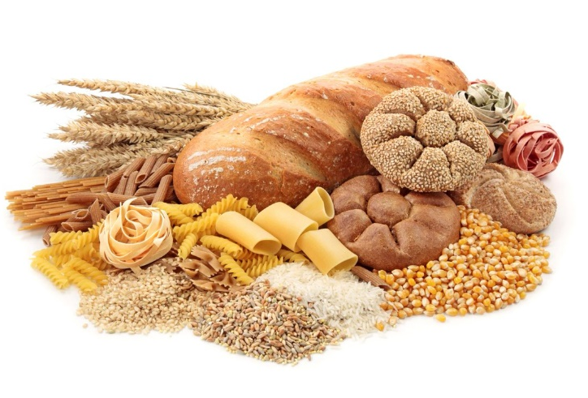

Choosing Whole-Grain
Make half your grains whole grains
  Look for whole grains listed first or second on the ingredients list—try
    Oatmeal
    Popcorn
    Whole-grain Bread
    Brown Rice
Limit grain desserts and snacks,
such as cakes, cookies, and pastries
Notes:
Some important tips to follow when considering grains is to make half of your grains-whole grains. Select foods like oatmeal, brown rice, and whole-wheat bread. The importance of whole grains are that they provide fiber that helps you feel full and can prevent and treat constipation. As opposed to refined grains, like white bread and white rice, which are processed, which removes many of the nutrients. To no surprise, it is important that we limit the consumption of grain desserts and snacks, such as cakes, cookies, and pastries because they have added sugars.

Slide 8

Move to Low-Fat or Fat-Free Milk or Yogurt
Choose fat-free milk, yogurt, and soy beverages (soy milk) to cut back on saturated fat.
Replace sour cream, cream, and regular cheese with low-fat yogurt, milk, and cheese.
Notes:
Earlier we mentioned ways to make drinking dairy products healthier. It is important to drink fat-free or low-fat milk because they will cut back on saturated fat. However, when making the switch, it is best that people slowly transition from whole milk to lower fat versions. We can also replace items like sour cream, cream, and regular cheese with low-fat yogurt and cheese. Many cheeses are high in saturated fat so it is best to look for “reduced-fat” or “low-fat” on the label. Try different brands or types to find the one that you like most. Cream cheese, cream, and butter are not part of the dairy food group. They are high in saturated fat and have little or no calcium. When recipes such as dips call for sour cream, substitute it with plain yogurt instead. Use fat-free evaporated milk instead of cream, and try low-fat or fat-free ricotta cheese as a substitute for cream cheese. Flavored milks and yogurts, frozen yogurt, and puddings can contain a lot of added sugars so it is best to consume those in moderation, or not at all.

Slide 9
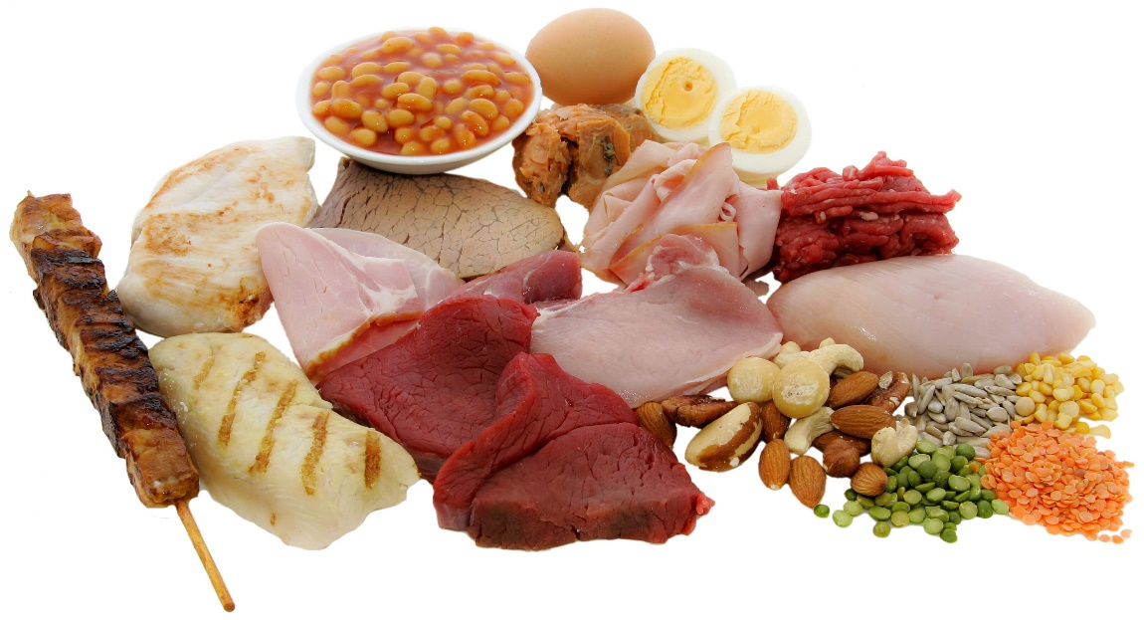
Vary Your Protein Routine
Mix up your protein foods to include
  Seafood
  Beans and Peas
  Unsalted Nuts and Seeds
  Soy Products
  Eggs
  Lean Meats and Poultry
Notes:
As we have mentioned earlier, protein is abundant in many types of food, most notably in seafood, beans, peas, unsalted nuts and seeds, soy, eggs, and lean meats and poultry. Protein is no different than the other food groups where eating in variety is essential. We mentioned that eating seafood twice a week is beneficial for someone who likes to eat animal based protein on occasion. A great way to combine protein with vegetables and fruits is by incorporating them all into a salad. You can do this by adding meats, nuts, beans, peas, eggs, and fresh or dried fruits to a salad. As we noted a few slides ago, the more colorful the better. When eating meats it is also important to choose lean cuts of meat like round or sirloin steak and ground beef that is at least 93% lean. In a later class, we will show you how to selected healthier meats over less healthy meats when making every day Hispanic recipes. Eggs can be an inexpensive protein option and part of a healthy eating style so make them a part of your weekly choices. Try beans and peas like kidney, pinto, black, or white beans; split peas; chickpeas; hummus, or soy products like tofu, tempeh, veggie burgers, nuts, and seeds. They are lower in saturated fat and some are higher in fiber. Nuts and seeds are a concentrated source of calories though, so eat them in small portions to keep calories in check. Try grilling, broiling, roasting, or baking foods because those methods do not add extra fat. Some lean meats need slow, moist cooking to be tender so try a slow cooker for them. Avoid breading meat or poultry, which adds calories. Choose turkey, roast beef, canned tuna or salmon, or peanut butter for sandwiches. Many deli meats, such as regular bologna or salami, are high in fat and sodium.

Slide 10
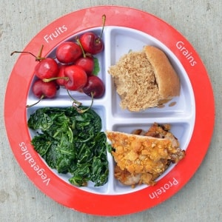
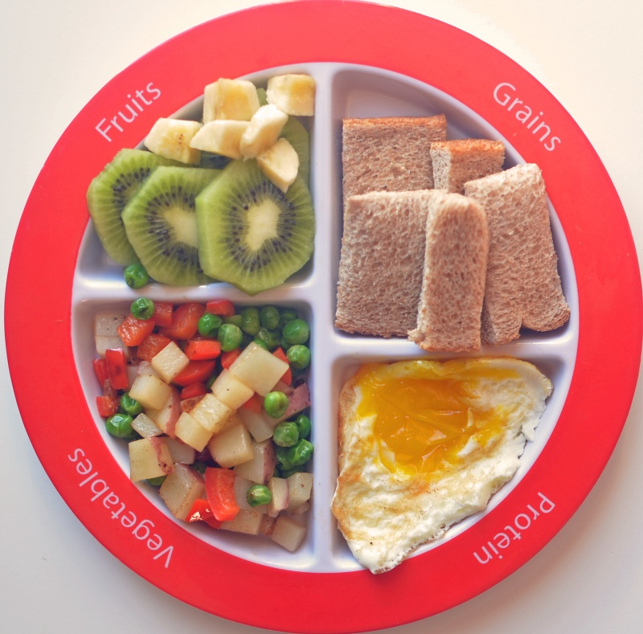
MyPlate Examples
Notes:
The main message that was shared in this class is that everything that we consume, whether eating or drinking, matters now and in the future to our health. It is important that we focus on a variety of foods from each group. When transitioning from unhealthy foods to healthier foods, it is good to start slow and make small changes to build healthier eating habits. As we can see from the pictures above, our plates should be filled with color and we should alternate the foods we eat as much as possible. The picture on the left shows a great lunchtime option. It contains red cherries, dark green spinach, a piece of meat, and a piece of whole-wheat bread. The picture on right, which also includes the four foods from Choose My Plate, incorporates bananas and bright green kiwi, a cocktail of different colored vegetables, a whole egg for protein, and pieces of sliced wheat bread. A healthy dinner example for a Fettuccine Alfredo with Italian sausage dinner meal is possible by making a whole wheat spaghetti and meatballs meal topped with a side salad. The original meal provides about 964 calories, 26 grams of saturated fat, and 1581 milligrams of sodium, where the whole wheat spaghetti offers 533 calories, 4 grams of saturated fat, and only 857 milligrams of sodium. For a fun size snack, we can supplement a plain yogurt topped with berries, granola, and nuts in place of fruit-flavored yogurt and a medium-sized muffin. These are just a few examples on how to create a healthy plate that meet the four desired food groups. Use your imagination and think of these designs when creating your own.

Slide 11
SUMMARY
Choose My Plate
Notes:
In this class we discussed the effectiveness in preparing a meal using the guidelines provided by Choose My Plate from the U.S Department of Agriculture. We went over some tips for building a healthy meal such as incorporating the five sections of the My Plate design to fulfill the nutritional needs of the body. We described different ways to measure food amounts and different ways to supplement healthier alternatives in common foods. Lastly, we mentioned some foods from each of the five groups and their nutritional properties, as well as some healthy meal suggestions. I hope you all gained some important knowledge from this class and select to follow the guideline recommend by Choose My Plate. In our next session, we will cover reflecting on your daily diet, and creating and setting new healthy goals.

