Slide 1




Pasos Para Prevenir Cáncer
Body Mas Index (BMI) and Waist Circumference
Notes:
Hello and Welcome back to Pasos Para Prevenir Cancer! Once again, my name is _____ and this week we will be discussing body composition and how it correlates with cancer.

Slide 2


Body Mass Index (BMI) and Waist Circumference
Notes:
Usually, when a person walks into a doctor’s office the first thing they do, even prior to getting their blood pressure check, is administer a body composition screening via anthropometric measurements. These measures include weight, height, body mass index, body circumference (arm, waist, hip & calf), waist to hip ration, elbow amplitude, and knee-heel length. The most common measures conducted, and those which we will discuss in this class, are weight, height, BMI, and waist circumference. Anthropometric measurements are important because they represent diagnostic criteria for obesity, which significantly increases the risk for conditions such as cardiovascular disease, hypertension, diabetes mellitus, and many more. These measures are used as a utility measure of nutritional for some populations and it can also be used as a baseline for physical fitness and to measure the progress of fitness. Before we start with how body composition is correlated with cancer, we will go over some data for the state of Texas.

Slide 3
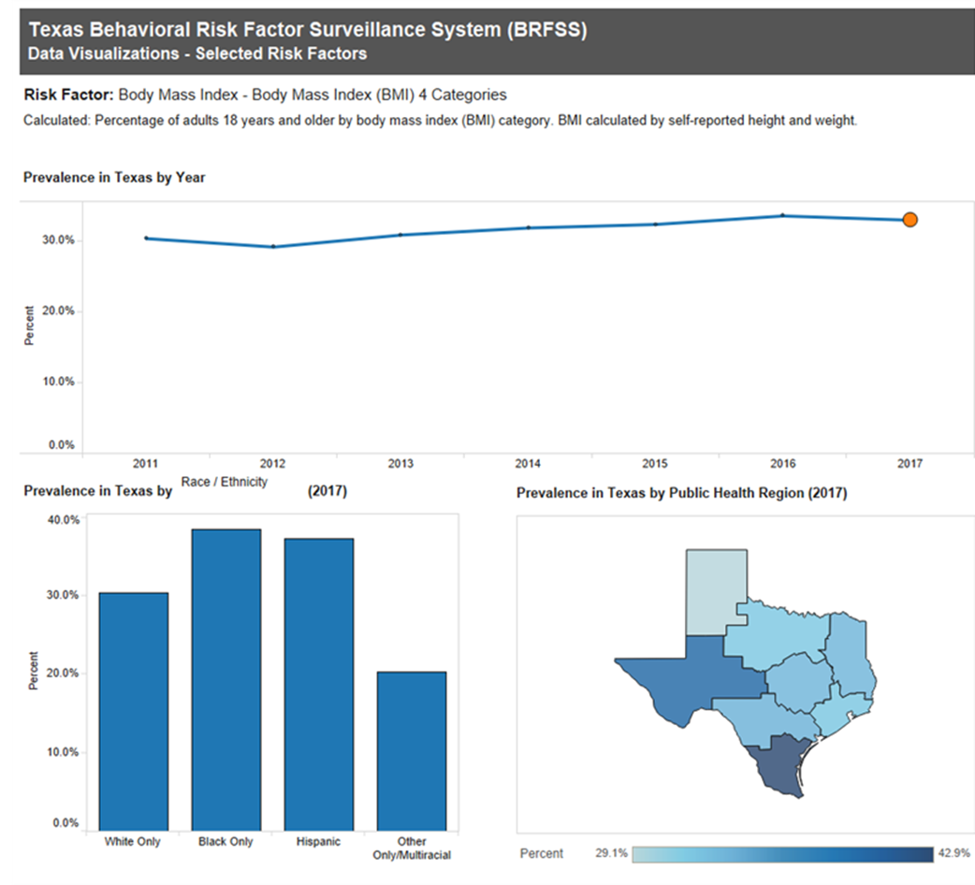
Notes:
The Texas Behavioral Risk Factor Surveillance System (BRFSS), is a federally supported landline and cellular telephone survey that collects data about Texas residents regarding their health-related risk behaviors, chronic health conditions, and use of preventive services. Texas BRFSS is an important tool for public and private health professionals at every level of the government because it is used to identify public health problems, set goals and priorities, design policies and interventions and evaluate long term impact of public health efforts. Data that is collected from the BRFSS includes smoking, obesity, high blood pressure, exercise and physical activity, cholesterol, immunizations, cancer screening, and other risk factors. According to this system, in 2016, 69% of Texas adults were classified as overweight or obese, with Texas having the 8th highest rate of obesity in the United States. As we mentioned in last week’s lecture, 13 different types of cancer have been linked to excess weight. By looking at the graph at the top of the page, we can note that since 2011 the average BMI for adults aged 18 and over in the state of Texas is greater or equal to 30.0%. We will go over the percentage markers for BMI shortly. Broken down by Race, the lower left-hand graph shows us that in 2017, those who reported themselves as White (only) averaged about 30% BMI, both Blacks and Hispanics averaged well above 36% BMI, and those in a multiracial or other category averaged 20% BMI. On the lower right we have a graphical representation of the prevalence of overweight and obesity in Texas broken down by Public Health Region in 2017. Based on the color line that is displayed at the bottom, the percentages go from least at 29%.1 percent, which is represented by a light blue color, to greatest in bmi which is 42.9% and is represented by the darkest blue. If we were to categorize the public health region from best to worst, based on color, the region that represents El Paso County would be the 2nd worst, which only bests the Rio Grande Valley, which coincidently, also serves as a major border to Mexico.

Slide 4
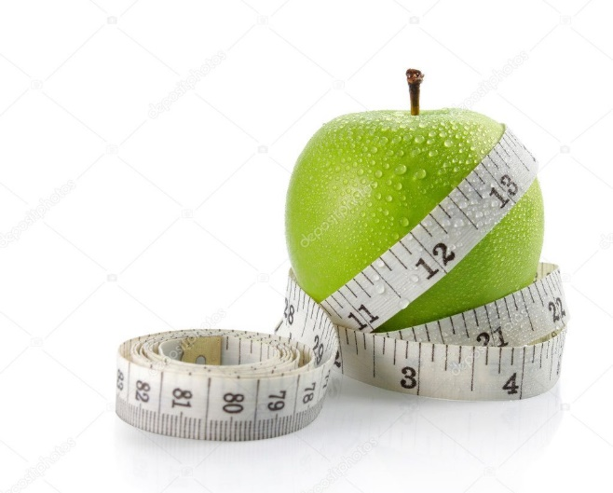
How is Healthy Weight Measured?
Body Measurement Index (BMI)
Waist Circumference
  Healthy waist circumference
    Males: Less than 40 inches
    Females: Less than 35 inches
Notes:
As previously discussed, BMI and waist circumference are two measures that health professionals conduct on people to determine their level of health and risk for chronic illness. Currently, BMI is broken down into five different ranges which include underweight, normal or healthy weight, overweight, obese, and extreme or high risk obesity. Underweight is categorized with a BMI less than 18.5. Normal or Healthy weight range is categorized by a BMI between 18.5 and 24.9. Overweight is categorized with a BMI between 25.0 and 29.9. Obese is categorized as a BMI between 30.0 and 39.9, and high risk obesity is categorized as a BMI over 40. Waist circumference is another way to estimate potential risk for chronic disease as previously mentioned. A healthy waistline for men would be a waistline less than 40 inches in diameter; anything above that is consider risky. For a non-pregnant woman, a waistline less than 35 is considered healthy, and anything above that is considered risky.

Slide 5
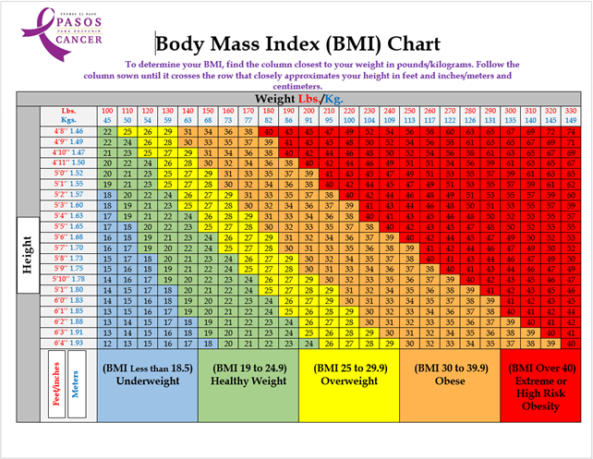
How is Healthy Weight Measured?
Body Mass Index (BMI)
measure of body fat based on height and weight that applies to adult men and women.
Higher BMI = Higher health risks.
Notes:
There are multiple ways to determine a person’s BMI by using a person height and weight. The formula for BMI is 703 x weight in lbs divided by height squared. For example. A person who weighs 205 lbs and is 5’8” or 68 inches would have a bmi of 31.2 based on the formula 703 x 205 lbs divided by 4624 which equates to 31.2. An even easier way to determine a person’s BMI, plus their categorical status based on BMI is by using a Body Mass Index Chart. As we can see from the BMI Chart provided, not only does this chart list the categories of weight that were given in the previous slide, but it also uses a color scheme to make categorizing easier. In these scheme blue depicts a healthy BMI and red, which is the universal alarm color, signifies extreme or high risk obesity. We will demonstrate how this chart is used shortly.

Slide 6
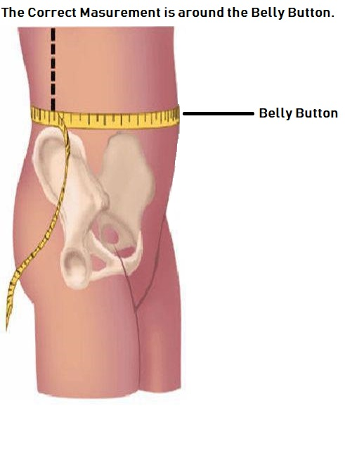
How is Healthy Weight Measured?
Waist Circumference
  Healthy waist circumference
    Males: Less than 40 inches
    Females: Less than 35 inches
Notes:
Earlier we discussed that waist circumference is also a method used to determine health risk. I also mentioned the healthy standards for both men and women. This diagram represents how someone would take a waist circumference measure. As you can see, a measuring tape is used to measure the individual’s waistline at the level of the belly button. I understand that most people do not have a measuring tape laying around, so just use your imagination and think about what people use to measure a pregnant ladies belly at a baby shower. One method I recommend is to get a piece of yarn, something that does not break, tear, or expand like a rubber band, and measure the waist. You can then measure the piece of yarn with a ruler or construction type tape measure to determine the length in inches. Next we will go over an example on how to find a person’s body mass index.

Slide 7
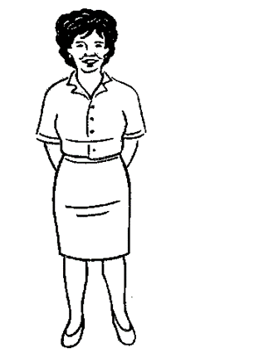
EXAMPLE
Virginia
She is 5 feet, 2 inches tall and weighs 130 pounds.
Notes:
In this slide we have a patient named Virginia who came into the doctors office to determine if she is at risk for obesity-related cancer based on her body mass index. As we can see Virginia is 5 feet, 2 inches tall and weight 130 pounds. On the next slide we will review Virginias height and weight and determine her body mass index category.

Slide 8
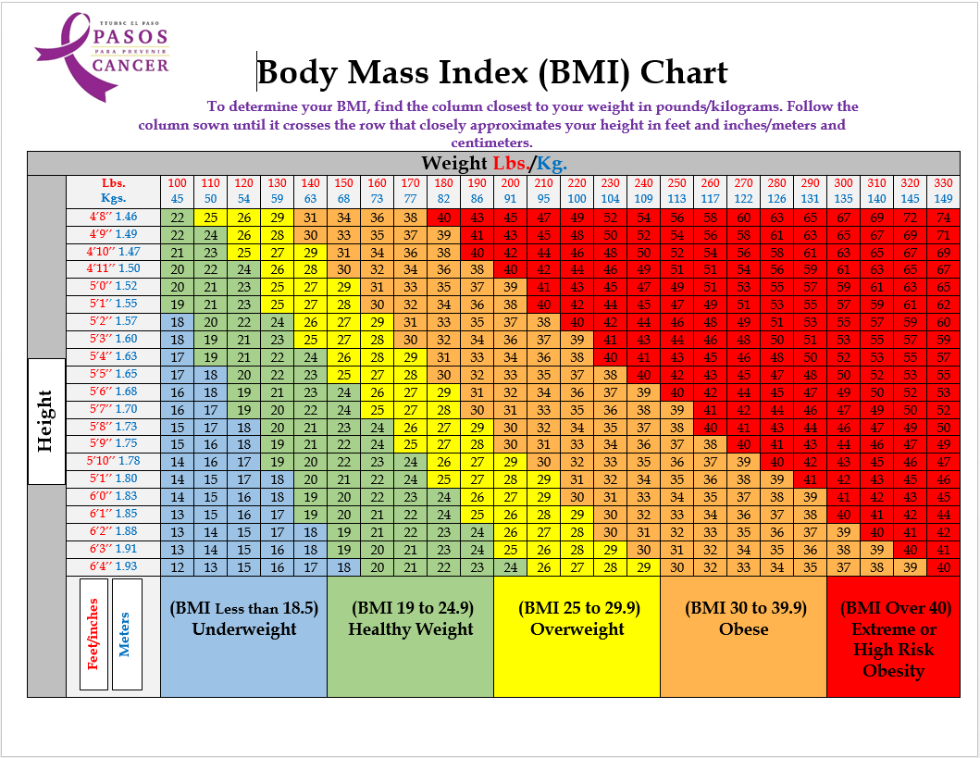
Notes:
To use the body mass index chart, we first determine Virginia’s height. If you recall, she is 5’2”. Height is found on the left-hand side of the chart. The next step is to determine her weight which is 130 lbs and can be located at the top axis of the chart. To get her bmi, we simply meet the height and weight at the number that intersects both columns. In this representation, Virginia’s BMI would be 24. Remember that there are two ways to determine her bmi category when using this chart. In this case you can use the number 24, which is less than 24.9 to determine that she is currently at a healthy weight. Or you can simply use the color scheme. The number 24 falls under the military green color which is labelled as healthy weight.

Slide 9
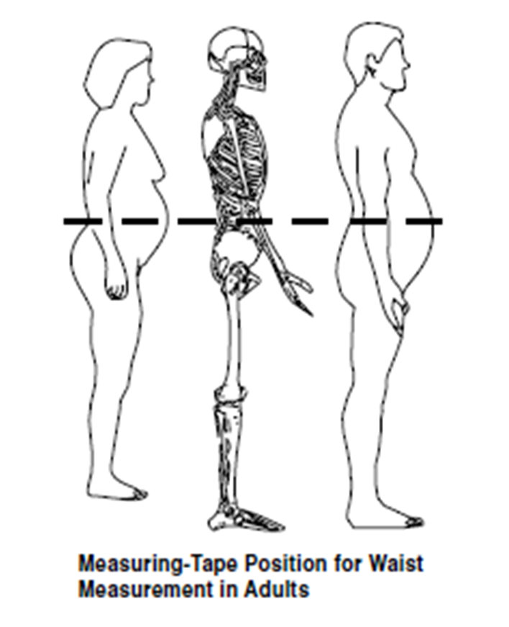
Why is a healthy waist circumference important?
Obesity Related Conditions
Type 2 diabetes
High blood pressure
Coronary artery disease
Notes:
We already discussed that waist circumference is an anthropometric measure that is used to determine health risk for certain chronic conditions such as type 2 diabetes, high blood pressure, and coronary artery disease. We also discussed that men who have a waist circumference that is more than 40 inches and women who have a waist circumference that is greater than 35 inches are at risk for these and many other chronic conditions. One thing to note is that while waist circumference and BMI are interrelated, waist circumference provides an independent prediction of risk over and above that of BMI. A very important thing to consider is that BMI does not account for Muscle Mass. For example, the BMI of a 5’8 210 lbs athlete would be 32, which falls under the overweight category. That very athlete could have a waist circumference that falls well below the 40 inch risk marker. Most people would not consider that athlete to be at risk and most people would categorize them as very healthy, even though their BMI is not at the healthy category. This does not make BMI useless, but rather promotes the use of both BMI and waist circumference when determining health risk.

Slide 10
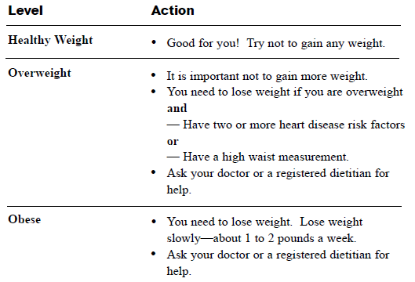
Notes:
Once you have determined your level of health based on body mass index and waist circumference it is time to take action. If you are at a healthy weight that's great for you! Try not to gain any more weight. For those who are overweight, it is important that you do not gain more weight. For those who need to lose weight and have two or more heart disease risk factors or have a high waist measurement, it is recommended that you ask your doctor or registered dietician for advice. For those who are obese, you need to lose weight slowly. The recommended amount of weight to lose is 1 to 2 pounds a week. This may seem impossible to some, however, throughout our upcoming lectures, we will share ideas with you that are backed by science and will help you attain a healthier lifestyle. As always, it is highly recommended that you seek guidance from your physician or a registered dietician before taking part in any diet programs.

Slide 11
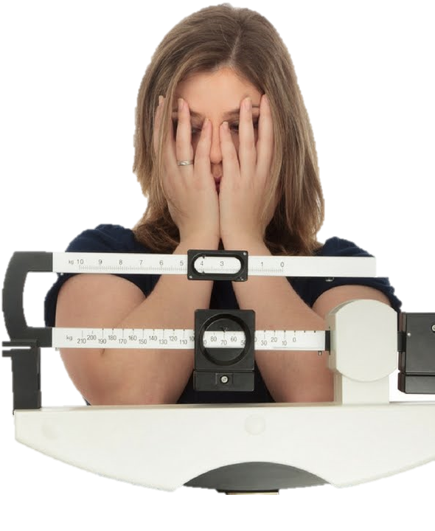
Risk Factors for Obesity.
Menstrual cycle
Perimenopause and menopause
Metabolism slowing down with age
Water retention due to dehydration or excess salt
Stress, depression, or anxiety
Lack of sleep
Medications that might make people gain weight rapidly include some drugs.
Notes:
As we have learned, obesity is a complex health issue that is defined as abnormal or excessive fat accumulation that can impair health. Obesity results from a combination of causes and contributing factors, including individual factors such as dietary patterns, physical activity, inactivity, medication use, and other exposures. Additional contributing factors in our society include the food and physical activity environment, education and skills, and food marketing and promotion. Some risk factors for obesity include menstrual cycle, perimenopause and menopause. The prevalence of obesity increases significantly in American women after they reach age 40; the prevalence reaches 65% between 40 and 59 years, and 73.8% in women over age 60. Studies have concluded that the average weight gain in perimenopausal women is about five pounds. The reasons for increasing obesity in menopausal women is not quite clear, however, some researchers argue that the absence of estrogens may be an important obesity-triggering factor. Other risk factors for obesity are the slowing of metabolism with age, water retention due to dehydration or excess salt, stress, depression, anxiety, lack of sleep, and medications that might make people gain weight rapidly. Next we will go over the benefits of having a healthy weight.

Slide 12
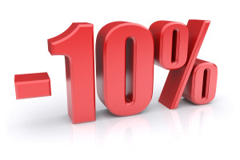
Start Slow
Losing 5-10 percent of current weight can improve health conditions.
  Cholesterol
  Hypertension
  Diabetes
  Insulin Resistance
  Sleep Apnea
  Knee pain
Notes:
As we discussed on the previous slide, some common risk factors for obesity are high blood pressure and hypertension, which are probable in people with high cholesterol. Other risk factors include diabetes, insulin resistance, sleep apnea, and knee pain. Some of these risk factors can be very debilitating, however, they can also be reversed or improved. Losing 5-10 percent of current weight can improve these health conditions. This is not going to happen overnight though. It is important to start slow and remain consistent with your healthy behaviors which include healthier diets and physical activity, which we will go over on a later date.

Slide 13
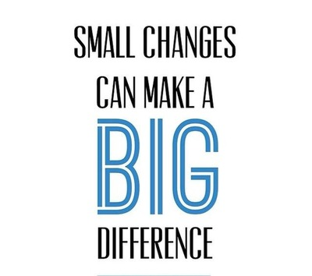
Managing Weight Related Chronic Conditions
Overweight and obesity are manageable medical conditions.
Manageable by changes in lifestyle.
Notes:
Overweight and obesity are manageable medical conditions that can be improved with lifestyle modifications like eating healthier and exercising. On our previous slide we mentioned that a 5-10% decrease of current weight can help improve many chronic conditions. The next few classes will go over ways to eat healthier and conduct physical activity.

Slide 14
Summary
Body Mass Index
  BMI Categories
  BMI Chart
Waist Circumference
  Male & Female Categories
Risk Factors for Obesity
Improving Health Conditions
Lifestyle Modifications
Notes:
In this class we mentioned some anthropometric measures that are routinely used by physicians and other professionals to determine and categorize health risks for people. Two measure that we place high emphasis on in Pasos Para Prevenir Cancer are body mass index and waist circumference. We informed you on how bmi is categorized from a scale of underweight to high risk obesity and how we can use a formula to determine a person’s bmi or simply use a BMI chart that is easier to follow. We also discussed how and why waist circumference is measured when assessing risk levels for chronic conditions. We ended our class by mentioning some risk factors for obesity and how to improve those health conditions by making small modifications in our daily routines. The upcoming classes will add to those lifestyle modifications that are essential in reducing obesity-related cancer. Just remember that this program does not ask people to diet or risk injury through physical fitness. Instead, we will show you ways to shop better, prepare healthier meals that you’ll enjoy, and show you how to fit physical activity into your busy schedules. I invite you to ask any questions or comments that you may have by commenting on this post, sending us a message on Messenger, or by emailing us to the provided email. I also invite you to come back to our Facebook page daily for new information and fun, family challenges that we have incorporated during these challenging times.

