Slide 1
Service Request Form Instructions
Research Core Laboratories

Slide 2
Requirements:
Adobe Acrobat (Full Version)
  In order to digitally sign form you must be using the full version of Adobe Acrobat
  Adobe Reader will not work

Slide 3
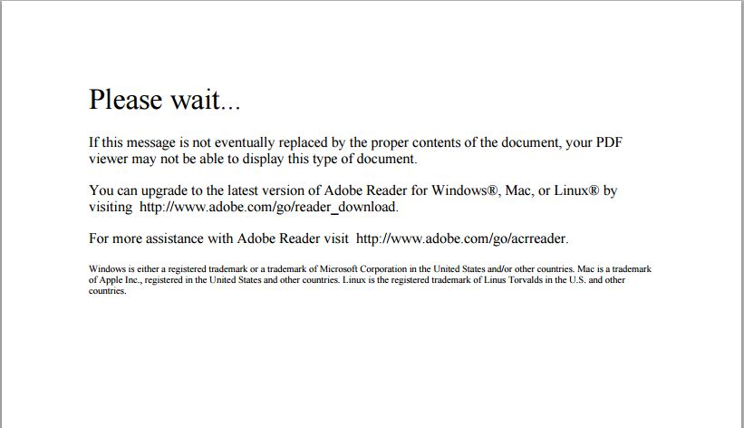
Service Request Form:
When clicking on the link in the webpage to download the form, and you receive this message please go to the following website and follow the instructions for the browser you are using.
https://helpx.adobe.com/acrobat/kb/pdf-browser-plugin-configuration.html

Slide 4
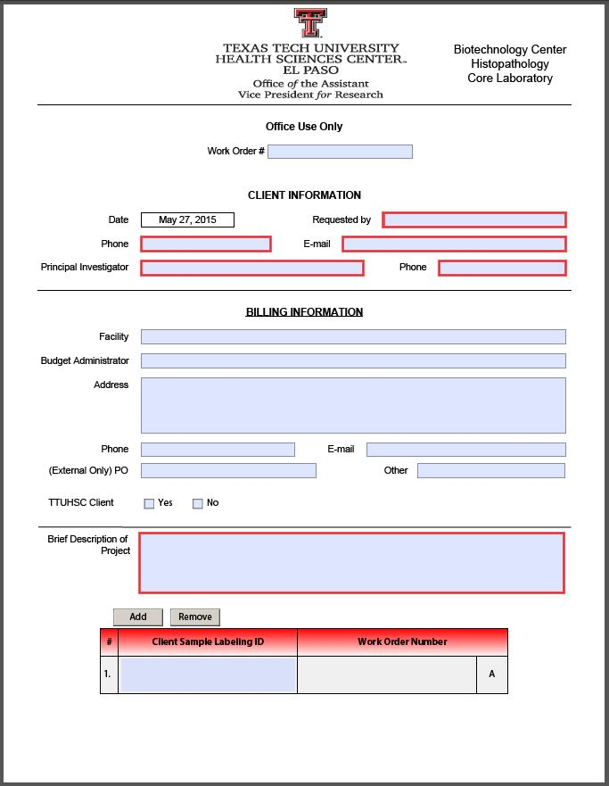
Service Request Form:

Slide 5
Service Request Form:
Fields with a red border are required fields, and must be filled in. If they are left blank you will not be able to submit.

Slide 6
Service Request Form:
Please insert your desired Sample Label ID so our techs know how you want your samples to be labeled. One Sample Label ID per row.

Slide 7
Service Request Form:
For each additional Sample Labeling ID simply click the button labeled “Add”, and another row will appear.

Slide 8
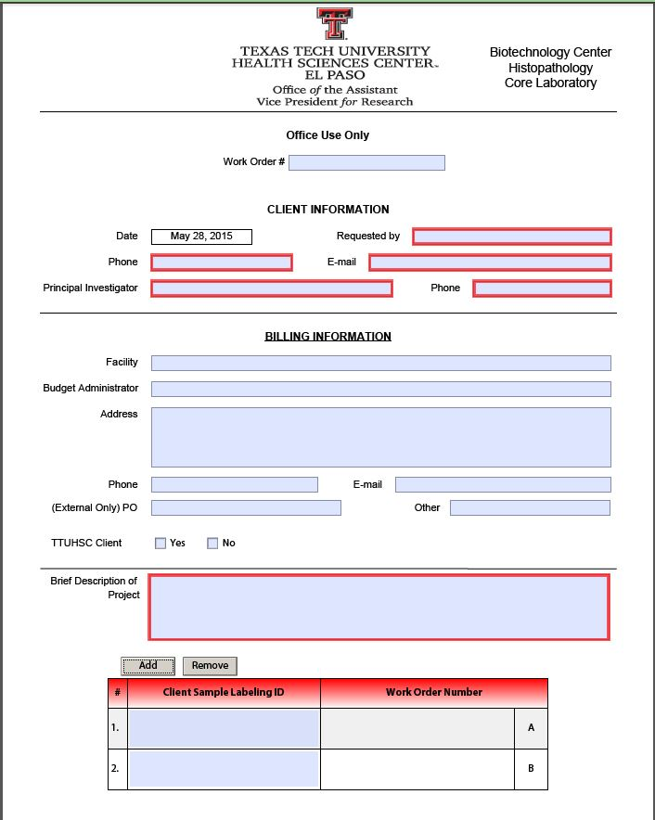
Service Request Form:
Once you click add you can now see another row has been added.

Slide 9
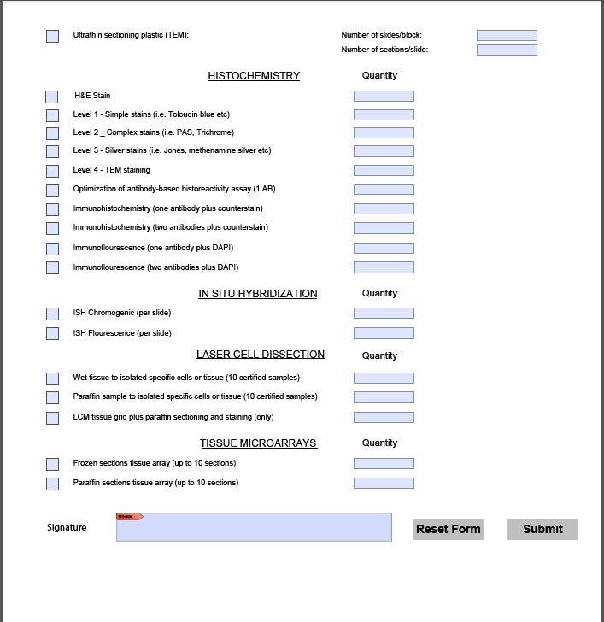
Service Request Form:
When you have completely filled out the form, next you will click the signature field to add your digital signature. *Note* To Digitally sign the form you must be using the full version of Adobe Acrobat, Adobe Reader will not digitally sign the form.

Slide 10
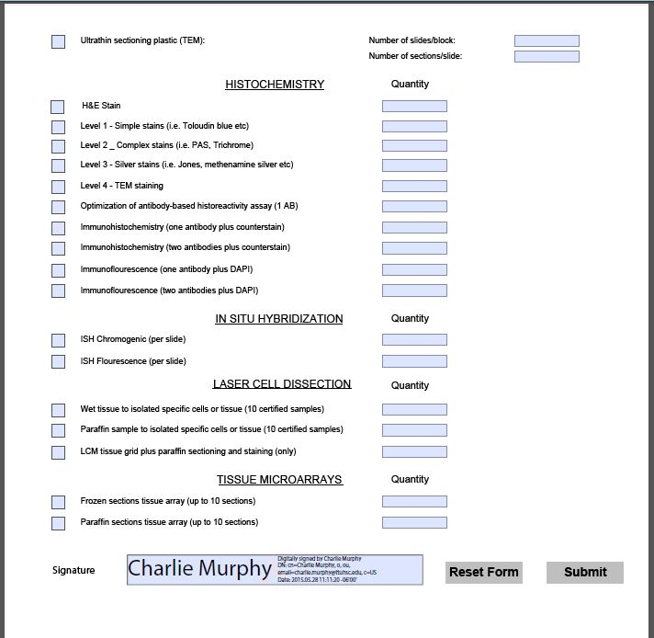
Service Request Form:
After you digitally sign the form you are now ready to click the submit button.

Slide 11
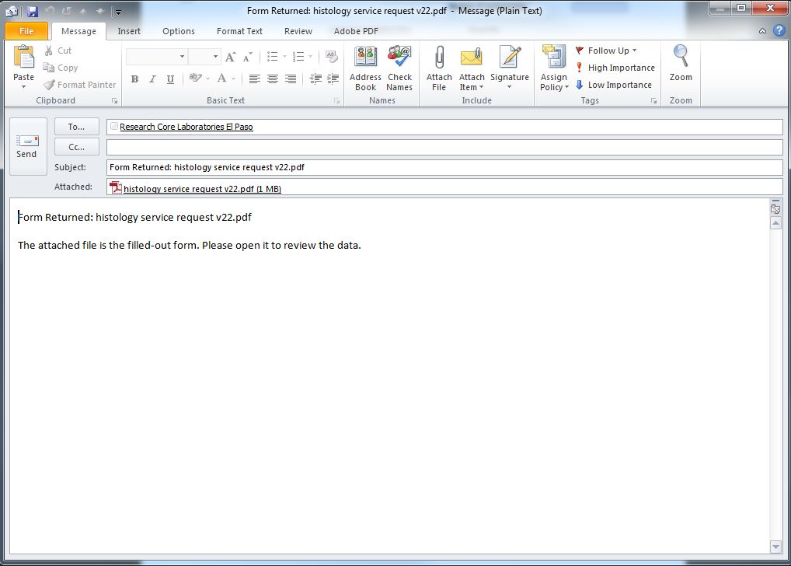
Service Request Form:
After clicking the submit button, your outlook will open an email that will send your service request form after you click the send button to the Research Core Laboratories. Your form has now successfully been submitted.

