Slide 2
Purchasing Card Policy Training
TTUHSC El Paso
Payment Services

Slide 3
Purchasing Card Policy Training
Contents Program Overview Responsibilities of Cardholder
Policies of Purchasing Card (PCard) Program
Recordkeeping
Reviews
Laserfiche

Slide 4
Overview
Utilizes a MasterCard credit card
Issued by the State of Texas
Allows users to purchase directly from vendors
Allows for single purchases up to $5000 and monthly card limit based on estimated usage
Prohibits some items and merchants
Transactions managed online with CitiDirect Global
Card Management System
Training is REQUIRED

Slide 5
ALL Pcard Users must complete training
EVERYONE who uses the PCard must complete and submit the Training Questionnaire to the Cardholder, who will forward it to PCard ELP – Payment Services
-Cardholders are required to submit a list to Payment
Services of all individuals who will use their card.
No one will be allowed to use the card until this has been completed.

Slide 6
Personal Responsibility
Proper use and protection of card
Use only for official TTUHSC El Paso allowed purchases
Keep in locked drawer or safe place
Verify proper recording of transactions to
Banner FOAPs
Abuse results in disciplinary action
Liable for unauthorized purchases
Possible termination of employment
No personal credit check

Slide 7
PCard Log
Maintain physical security of card and document transfer of custody.
- Cards should be kept locked and secured.
Log should reflect who has the card, when they
picked it up and when they returned it.
Each cardholder is required to keep a log of who has used their card.
The card user is responsible for providing all required back-up for their transaction.
Submit monthly with Pcard records.

Slide 8
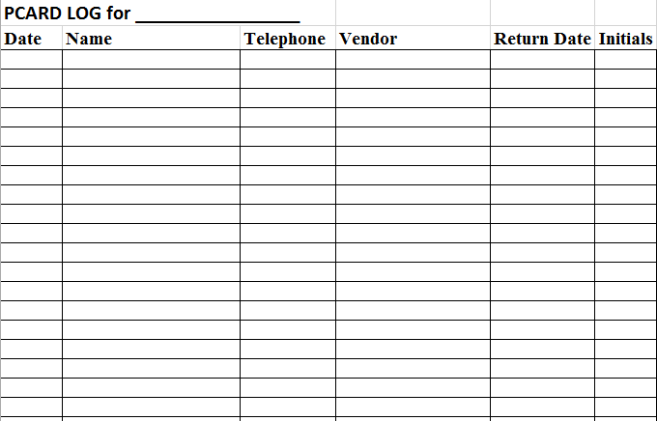
PCard Log Example

Slide 9
Obtaining a PCard
Complete PCard application and agreement form http://elpaso.ttuhsc.edu/fiscal/businessaffairs/paymentservices/Forms.aspx
Complete required PCard training module and questionnaire
http://www.fiscal.ttuhsc.edu/busserv/pcard/collateral/pcard_training_questionnaire.pdf
Return questionnaire to Payment Services ELP
For additional questions, email the PCard program coordinator at PcardELP@ttuhsc.edu

Slide 10
Activation of PCard
Card must be activated upon receipt
See strip on card for instructions
Remember, CitiBank cards require a PIN at time of activation

Slide 11
Purchase Guidelines
Compliance
State of Texas Policies
Use of Payment Cards by State Agencies
TTUHSC El Paso Policies & Procedures
HSC OP 72.15 Purchasing Card Program
HSC OP 72.03 Direct Pay Expenditures
HSC OP 72.16 Official Functions, Business Meetings & Entertainment
HSC OP 72.01 Purchasing Supplies, Equipment &
Services
Internal departmental procedures

Slide 12
Verify Warrant Hold Status
Before purchasing goods or services over $500 (effective 11/01/08) with the purchasing card, the cardholder should verify if a potential vendor is indebted to the State of Texas and identified as being on Warrant Hold Status.
Comptroller’s website:
https://cpafmprd.cpa.state.tx.us
Print a copy of the vendor status and include
with records.

Slide 13
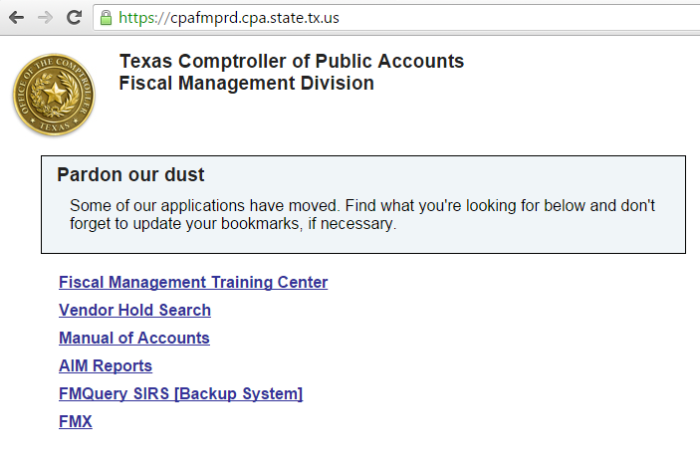

Slide 14
PCard Purchasing Information
Allowed purchases of less than $5,000
Deviation approval from Purchasing ELP is required PRIOR to making a purchase for prohibited items or using vendors other than the ones on Tech Buy.
Flowers
Must use PCard
Official TTUHSC El Paso functions
Employee and immediate family only
No substitution for this type of purchase
Prohibited on state accounts

Slide 15
Food & Entertainment
Must be documented by the following:
Invoice/Receipt
Food & Entertainment Substantiation Form is required for ALL food and entertainment purchases.
Complete list of attendees is required – Attach sign in sheets or list separately if more than five attendees.
Pre-Approval Form REQUIRED PRIOR TO PURCHASE if $500 or more. If Approval was not obtained, the Card User is personally responsible for charges over $499.99 that were not pre-approved.
Include required documentation with expense report
Prohibited on state accounts

Slide 16
Prohibited Purchases
HSC OP 72.15 Purchasing Card Program Item 2.b.
Prohibited Purchases
Awards and prizes (see HSC OP 72.03)
Chemicals and other potentially hazardous materials
Consulting, medical services, personal or professional services
Controlled assets > $500 (shipping included)
At any cost – Hand guns, rifles, machine guns, etc.
With a cost between $500 and $4,999.99 –Cameras, computers (including peripherals), printers, stereo systems, video recorder/laser disk player (TV, VCR, camcorder), projectors and etc.

Slide 17
Prohibited Purchases
Donations, contributions & sponsorships
eBay purchases
Lease or rental of space
Malpractice insurance
Medical licenses for states other than the State of Texas
Notary applications
Payments to patient/study participants

Slide 18
Prohibited Purchases, continued
PayPal services
Supplies (medical, pharmaceuticals, and office) require use of the Institutional Supply Contract unless a deviation approval has been received from Purchasing)
Temporary personnel
Travel related purchases (i.e., airline ticket, hotel and rental car reservations, restaurant services within a hotel complex, and internet services, etc.)
Uniforms (includes lab coats)

Slide 19
Prohibited Purchase – Anything with Logos
Purchases for anything with logos are NOT allowed on the PCard and must go through the PO process – no exceptions!
Includes clothing and business cards
For additional information regarding logos, please contact Institutional Advancement.

Slide 20
Prohibited State and Federal Purchases
Alcoholic beverages
Food and entertainment
Flowers
Promotional items
Membership dues
State and federal funds
10XXXX, 11XXXX, 12XXXX, 21XXXX, and 22XXXX

Slide 21
Order With a Pcard
Ordering Methods
Telephone
Fax
Internet (print screen for proof of purchase for
documentation)
Itemized Invoices Required
Ask vendor for an itemized invoice
Sales tax (State of Texas) on an invoice must be credited by the vendor or personally reimbursed to TTUHSC El Paso.
Tax Exemption Forms

Slide 22
Supporting Documentation
If Transaction Log is not used, each receipt or invoice must reflect the required information to support the purchase as a legitimate state expense
Documentation needed to be in compliance with record keeping requirements:
Expense report with appropriate signatures
Invoice/sales receipt from the vendor and/or print screen prior to submission for online orders
Business purpose written on the supporting documentation, or in the available field of the expense report, or the transaction log/interdepartmental form

Slide 23
Supporting Documentation
Credit card slip taped on the invoice or itemized receipt
Registration – order form detailing each charge for the conference
Membership dues - the enrollment form detailing the charges for the type of dues or the renewal notification/invoice and the print screen from the list of approved professional societies
Flower purchases - the employee or recipient’s name
and their relationship to the employee
Other items (if applicable) - packing slips, Pre-Approval Form, F&E Substantiation Form, deviation approval from Purchasing, copy of advertisement , and/or credit receipts
Expense descriptions are required to be entered in Citibank in order to appear on the expense report.

Slide 24
Supporting Documentation
Required Information on Invoice or Receipt
Last four numbers of the credit card
Date
Merchant name
Amount
Sales tax (if applicable)
Tape small receipts on documentation form or blank sheet of paper
Do not place tape on top of any of the above
information

Slide 25
Food & Entertainment
Not allowed on state funds
Permitted on local funds unless restricted by account
Must be a clear and specific business purpose
identified
Proper documentation is required
Must include a Food & Entertainment Substantiation
Form and/or Pre-Approval Form if $500 or more

Slide 26
Food & Entertainment Documentation
Follow IRS guidelines Documentation including:
Amount
Time, place and description of entertainment
Business purpose and benefit to TTUHSC El Paso and the State of Texas
Business relationship of person(s) entertained
Name, title and occupation and complete list of attendees

Slide 27
Reimbursement for PCard Transactions
The check or cash must be sent to the PCard
Coordinator for correct processing.
A CR form will be completed by the PCard coordinator immediately upon receiving the payment and submitted to the Bursar’s office. The FOAP used will match the original transaction as it was processed in Banner.
A copy (CR and payment) will be made for the cardholder folder and also sent to the department. The department copy is to be put in the transaction log binder for review purposes.
Note: All reimbursements must be sent to the P Card coordinator for processing to:
• Katherine Escandón - Payment Services ELP

Slide 28
Missing Receipts
Cardholder must attempt to get a copy of the
original documentation
If unsuccessful:
Three attempts to get copy must be documented
Missing Receipts Form must be completed
Missing Receipts Form
Account manager/supervisor signature required
Keep form with other documentation
Missing receipts should be a rare occurrence
and will be carefully scrutinized in reviews

Slide 29
Monthly Expense Report
User generates monthly expense report from Citi
purchasing card management system
Cardholder lists all transactions and verifies all transactions are legitimate
Match each transaction on expense report to your
receipts
Match credit card expense report to your Cognos
Operating transaction reports
Place receipts and any other required documentation behind your expense report
Receipts and required documentation must be submitted in the
same order as transactions appear on the credit card expense report

Slide 30
Monthly Expense Report
Expense report must be signed by cardholder and fund manager, or supervisor or department administrator if the cardholder is the fund manager every month.
Each fund manger must approve charges to their
funds
TTUHSC El Paso Payment Services will pay the bill, then the transactions will be expensed to your departmental account
Transactions are reflected in your Cognos Operating Transaction reports
Transaction ID - CPXXXXXX
Transaction description – cycle end date, first six letters
of the cardholder’s name and merchant name
All transaction lines for each cardholder added together
should equal the expense report total

Slide 31
Cognos Reports
Reconcile PCard Transaction to Banner using Cognos.
HSC El Paso Finance > Transaction Detail > P-Card Transactions

Slide 32
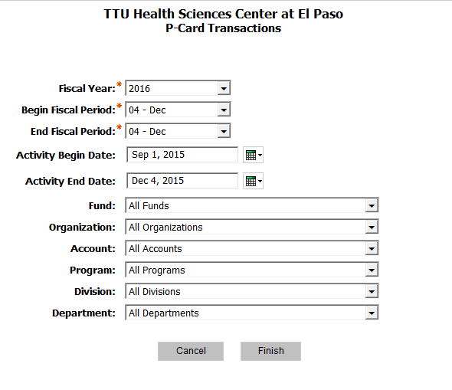

Slide 33
Allocations
Citi
Transactions that need to be reallocated to another FOP, rather than the default FOP that is tied to the card, can be processed as soon as two days after the purchase. Check the account code for each transaction to ensure it accurately describes your purchase. The link to the Citi website is below:
CitiDirect Global Card Management System
Close date for reviewing and reallocating FOAPs in order to load to Banner correctly is approximately six business days after the close of the monthly cycle

Slide 34
Allocations
Cost transfer requests after the PCard upload have been expensed in Banner should be a rare occurrence due to the ability to reallocate transactions in Citi
Cost transfers will be required to correct inaccurate account code being used
The Financial Transaction System (FiTS) Cost Transfer (located on Accounting Services website) should be used to submit all cost transfer requests.
The Cost Transfer Request Form (located on Accounting Services Forms website) must be used to change an account code for a current FY expenditure.

Slide 35
Disputed Items
Call vendor first – resolve with them
If item not resolved with vendor, call Citi Customer Service at (800)248-4553 to dispute the transaction
Important Note: If disputing a US vendor item, the claim must be completed within 60 days from the cycle end date of the expense report.

Slide 36
PCard Cancellation
If cardholder changes departments or leaves TTUHSC El Paso the PCard must be
Cut in half and returned with a written card cancellation request to the PCard coordinator
Katherine Escandón - Payment Services ELP

Slide 37
Employee Terminations
Account Manager has the obligation to reclaim the card from the terminated employee
Fraudulent charges incurred between employee termination date and card cancellation date do not have liability coverage
Call PCard coordinator within two days
Card must be returned with the transaction documentation since the last review date to the PCard coordinator
Katherine Escandón - Payment Services ELP

Slide 38
Record Keeping
Simple system
3-ring binder
File folder
One binder or folder for each card identified by
cardholder name or last four digits of the card
Monthly Expense Report
Transaction Log if maintained
Receipts, along with all supporting documentation, in same order as transactions on Expense Report

Slide 39
Record Retention
Standard Retention Period
Current year plus three previous fiscal years
Grant & Contract Accounts
Life of grant or contract, plus three years
Terminated employees
Must be reviewed as soon as card is cancelled
Standard retention period

Slide 40
Reviews and Spot Checks
Spot Checks
Previous day’s transactions reviewed daily
Reviews
The Expense Report and its supporting documentation will be sent to Payment Services ELP based on the month ending cycle.
The monthly PCard Update will announce the due date for each monthly review and when it is expected in Payment Services ELP.
Upon final completion of the review, the Expense Report and its supporting documentation will be sent to Laserfiche to be scanned.

Slide 41
Laserfiche
General Services will charge the departments $.065 per sheet sent to Laserfiche.
The default FOP affiliated with each card will be used
to charge the scanning cost.
Laserfiche will be available to all employees and HSC Internal Audit through Weblink. It will also allow a timely gathering of information for audits conducted by federal and state agencies.
Original documentation will be kept for three years plus
the current Fiscal Year in Payment Services’ storage

Slide 42
Laserfiche
Preparing the Records for Scanning:
Remove all staples
Do not place transparent tape over invoice/receipt transaction date, amount, description of item, or vendor name. The tape “fades” the printed info.
If the full 16 digit card number is notated on any supporting document, block out the first ten digits of card number and the three-digit security code.
Block out personal information.

Slide 43
PCard Contacts
Program Coordinator
Katherine Escandón
Email: PcardELP@ttuhsc.edu Phone: (915)215-4791
Unit Associate Director of Payment Services
Raquel Diaz-Jaquez
Email: raquel.diaz-jaquez@ttuhsc.edu
Phone: (915) 215-6161

Slide 44
PCard Contacts
Director of Purchasing
Annette Hinojos
Email: Annette.A.Hinojos@ttuhsc.edu
Phone: (915) 215-4582
Citi
Customer Service
Phone: (800) 248-4553

Slide 45
PCard Application & Training Questionnaire
Application:
Purchasing Card Application and Agreement
Print and complete the form including all cardholder information, default FOP and Account Manager signature
Training Questionnaire:
Purchasing Card Knowledge Quiz
Print and complete the quiz with signature on second page
Completed forms should be mailed to Payment Services ELP
• Requested cards will be available in about two weeks

Slide 46
Questions?
If you are ever in doubt about a purchase, please contact us prior to making the purchase.
PcardELP@ttuhsc.edu

