Slide 1
Maternal Mortality due to
Cardiovascular Disease
Lisa M. Hollier, MD, MPH, FACOG
Professor, Baylor College of Medicine
ACOG President, 2018-19

Slide 2
Presenter Disclosure
I have no conflict of interest to disclose
I have no financial or scientific disclosures
I have no off-label disclosures

Slide 3
Learning Objectives
At the completion of this session, the participants will be able to:
  Identify the contribution of cardiac disease to maternal mortality
  Understand causes and contributing factors
  Utilize screening algorithms to identify women at risk
Notes:
…….A spotlight has been turned to focus on Maternal mortality

Slide 4

CVD Case Presentation
25 year old obese (BMI 38) African-American G2P2 presents 10 days after an uncomplicated vaginal delivery with fatigue and persistent cough since delivery.
BP 110/80, HR 110, RR 28, afebrile, with O2 sat 94% on room air.
She gets diagnosed with respiratory infection and is prescribed an antibiotic. Fatigue is attributed to lack of sleep.
©California Department of Public Health, 2017; supported by Title V funds. Developed in partnership with California Maternal Quality Care Collaborative Cardiovascular Disease in Pregnancy and Postpartum Taskforce. Visit: www.CMQCC.org for details
Notes:
TALKING POINTS, Updated 8/16/17
This case is representative of cardiovascular deaths reviewed by CA-PAMR. Maternal mortality due to cardiac disease primarily revolved around the lack of awareness of CVD at both patient and provider levels, coupled with delays in diagnosis. In most cases, diagnosis was made in the perimortem period or at the time of autopsy

Slide 5
CVD Case Presentation (CONTINUED)
One week later, she presents again with continued symptoms. Antibiotics are switched and beta-agonists are added for presumptive “new-onset asthma.”
Two days later, the patient experiences cardiac arrest at home and resuscitation attempts are unsuccessful.
Autopsy findings were indicative of cardiomyopathy.
Notes:
TALKING POINTS, Updated 8/16/17
This case is representative of cardiovascular deaths reviewed by CA-PAMR. Maternal mortality due to cardiac disease primarily revolved around the lack of awareness of CVD at both patient and provider levels, coupled with delays in diagnosis. In most cases, diagnosis was made in the perimortem period or at the time of autopsy

Slide 6
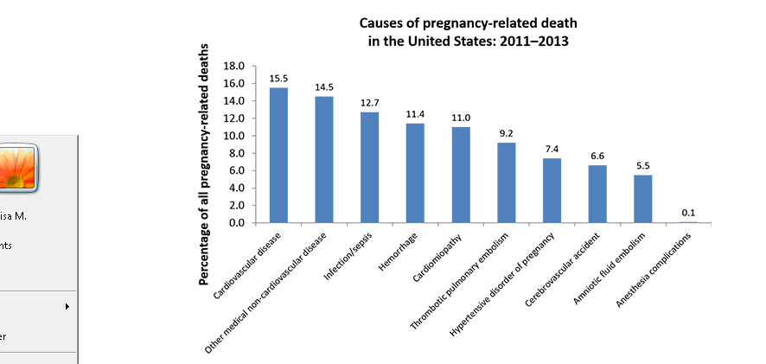
Pregnancy Mortality Surveillance System
https://www.cdc.gov/reproductivehealth/maternalinfanthealth/pmss.html
Notes:
These are the causes, but it doesn’t tell us why….

Slide 7
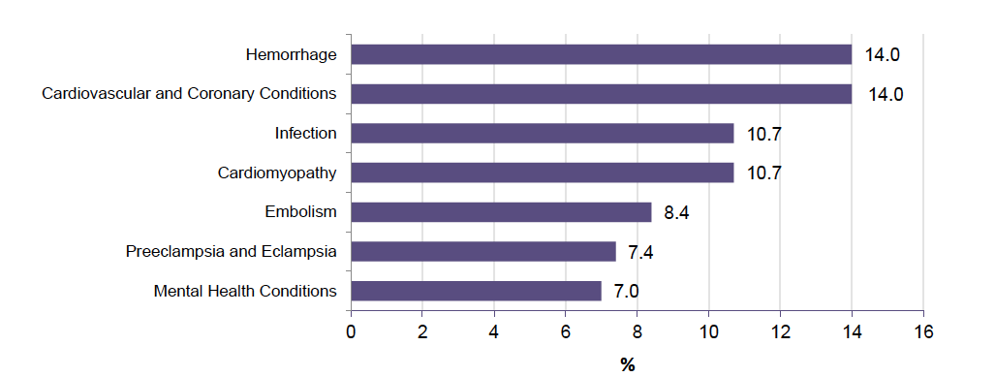
Results from MMRIA
Building U.S. Capacity to Review and Prevent Maternal Deaths. (2018). Report from nine maternal mortality review committees. Retrieved from http://reviewtoaction.org/Report_from_Nine_MMRCs

Slide 8
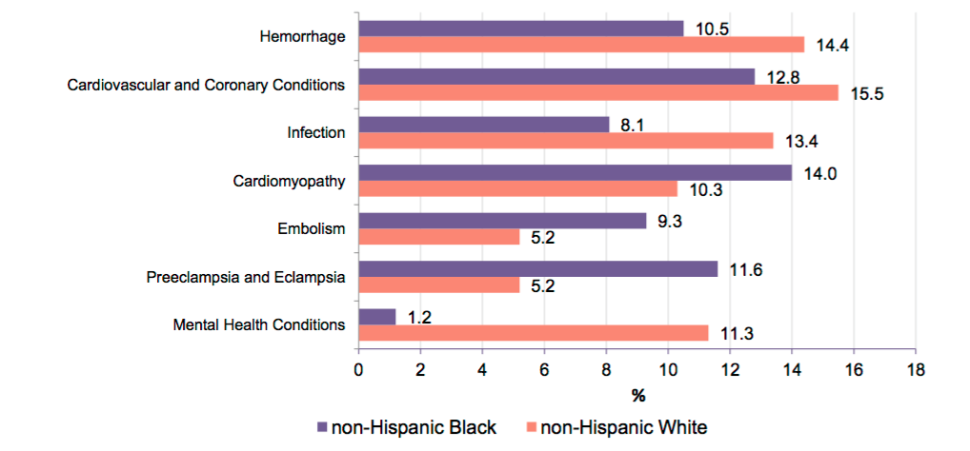
Results from MMRIA
Building U.S. Capacity to Review and Prevent Maternal Deaths. (2018). Report from nine maternal mortality review committees. Retrieved from http://reviewtoaction.org/Report_from_Nine_MMRCs

Slide 9
Texas Maternal Mortality
2012 Maternal Deaths Reviewed by MMMTF
89 deaths were identified
  34 cases (38%) were categorized as pregnancy-related
  50 cases (56%) were categorized as pregnancy-associated, but not pregnancy-related
  5 cases (6%) pregnancy-relatedness could not be determined

Slide 10
Texas Pregnancy-related Mortality
Leading underlying causes of pregnancy-related death identified by the Task Force were:
  cardiovascular and coronary conditions
  obstetric hemorrhage
  infection/sepsis
  cardiomyopathy
  preeclampsia/eclampsia, mental health conditions, and amniotic fluid embolus
Notes:
These 4 causes accounted for 76 percent of all pregnancy-related deaths.7,8

Slide 11
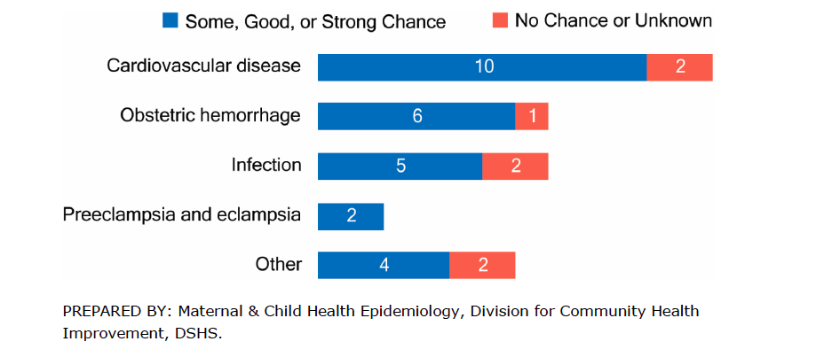
Preventability of PRM

Slide 12
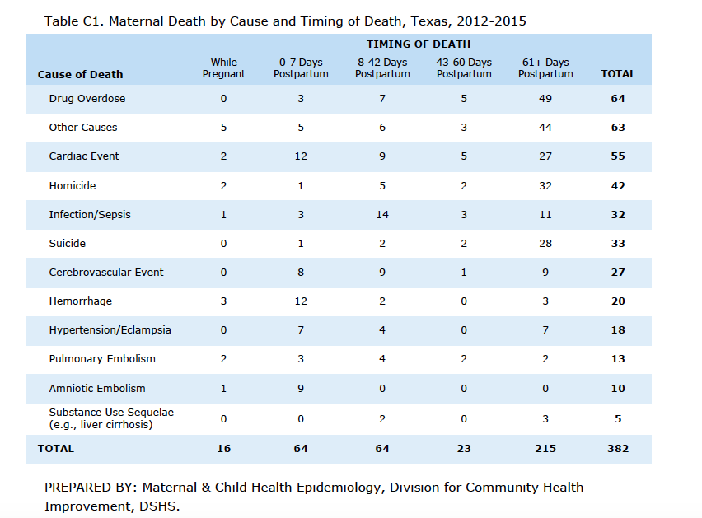

Slide 13
Demographics of Cardiac Disease
Illinois data
  Maternal mortality rate due to cardiac disease rose with advancing maternal age
  Black women had 3-times the rate of maternal mortality due to cardiac disease compared to white women
  Acquired heart disease was the predominant etiology (97.1%)

Slide 14
Cardiomyopathy
Cardiomyopathy
Dilated
Peripartum
Non-Peripartum
Hypertrophic
Primary
Secondary
Secondary to alcohol or drugs
Secondary to hypertension, drugs, valvular disease
Hameed AB, et al. Am J Obstet Gynecol 2015;213:379.e1-10.
Notes:
Cardiac disease in pregnancy can present as heart failure, arrhythmias or sudden death, and ischemia.

Slide 15
Cardiovascular Disease
Other Cardiovascular
Pulmonary hypertension
Aortic dissection
Possible arrhythmia
Non-valvular congenital
Coronary artery disease
Valvular disease
Hameed AB, Lawton ES, McCain CL, et al. Pregnancy-related cardiovascular deaths in California: beyond peripartum cardiomyopathy. Am J Obstet Gynecol 2015;213:379.e1-10.
Notes:
Preventability was assessed by whether
specifi c and feasible actions, had they
been implemented, might have changed
the course of the woman’ s trajectory and
led to a nonfatal outcome, asmeasured on
a 4-part continuum: strong, good, some,
or no chance.

Slide 16
Health Care Provider Factors in Cardiovascular Deaths

Slide 17
Health Care Facility Factors in Cardiovascular Deaths

Slide 18
Individual Factors in Cardiovascular Deaths

Slide 19
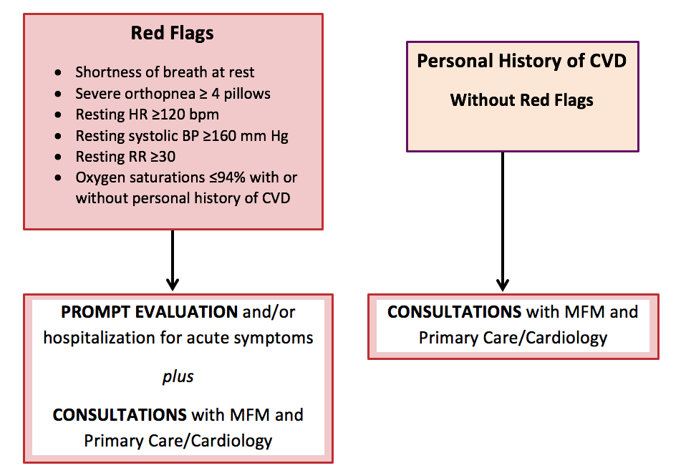
CVD Assessment Algorithm
For Pregnant and Postpartum Women
©California Department of Public Health, 2017; supported by Title V funds. Developed in partnership with California Maternal Quality Care Collaborative Cardiovascular Disease in Pregnancy and Postpartum Taskforce. Visit: www.CMQCC.org for details
Notes:
TALKING POINTS, Updated 8/16/17
The goal of the algorithm is to assist providers in distinguishing between signs and symptoms of cardiac disease and those of normal pregnancy and to guide clinicians in the triage of further cardiac evaluation, appropriate referrals and follow-up of pregnant and postpartum women who may have cardiovascular disease. Drawing from the literature and analysis of cardiovascular deaths reviewed in the California Pregnancy-Associated Mortality Review (CA-PAMR), the authors created this algorithm based on risk factors, symptoms, vital sign abnormalities, and physical examination findings commonly identified in women who die of various types of cardiovascular disease.
The most severe symptoms and vital sign abnormalities are labeled as “Red Flags” and include shortness of breath at rest, severe orthopnea necessitating sleeping upright with 4 or more pillows, resting heart rate > 120 beats per minute, resting systolic blood pressure > 160 mm Hg, resting respiratory rate of > 30 breaths per minute and an oxygen saturation < 94%. The presence of Red Flags OR a personal history of cardiovascular disease in pregnant or postpartum women should lead clinicians to conduct a prompt evaluation and seek consultations with specialists in maternal fetal medicine, primary care, or cardiology. If other less severe symptoms and vital sign abnormalities are identified, then risk factors and physical examination findings may need to be combined to stratify the women who require further work-up or routine follow-up.

Slide 20
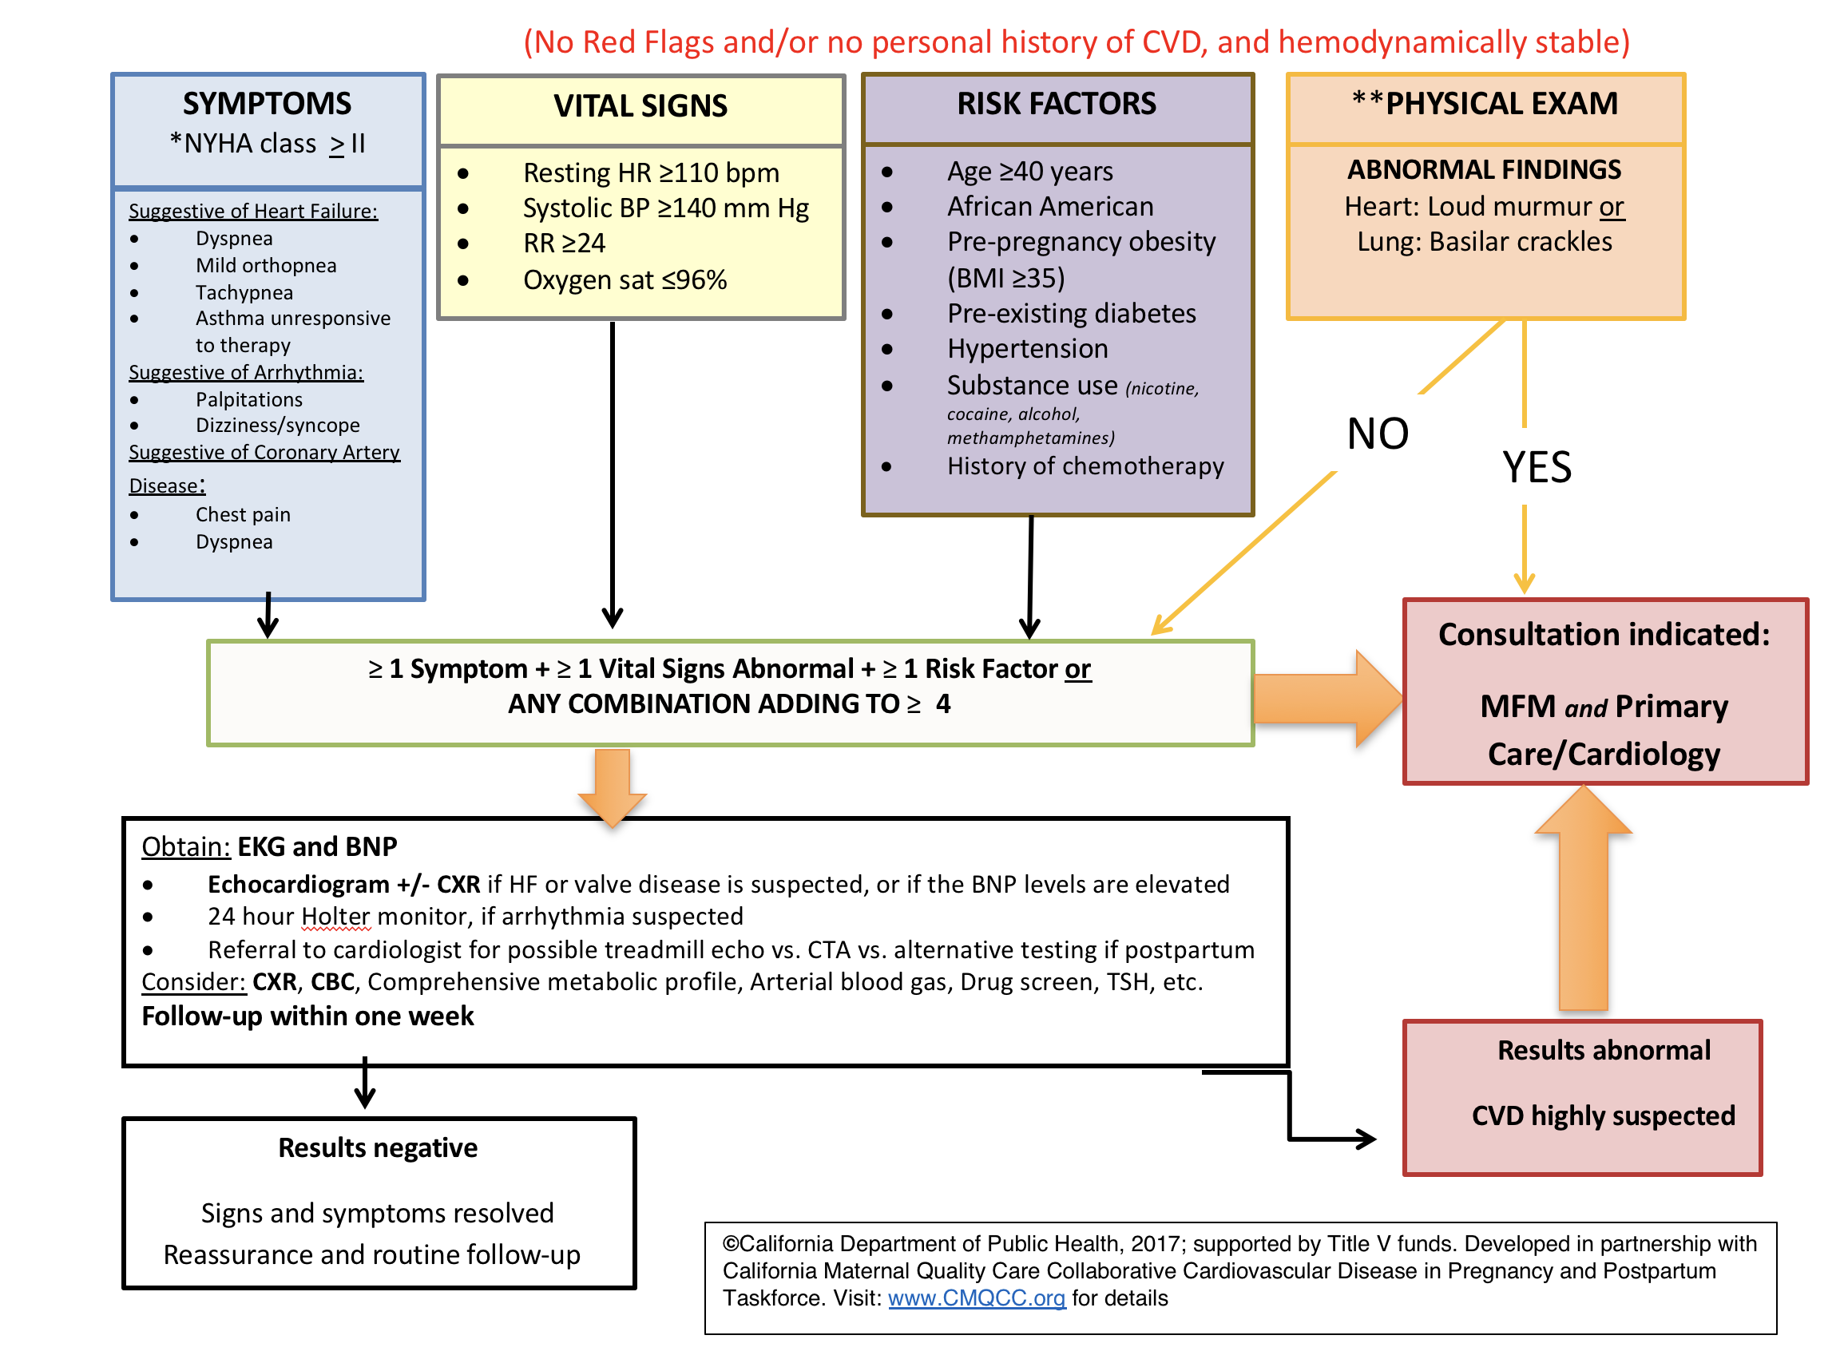
©California Department of Public Health, 2017; supported by Title V funds. Developed in partnership with California Maternal Quality Care Collaborative Cardiovascular Disease in Pregnancy and Postpartum Taskforce. Visit: www.CMQCC.org for details
Notes:
TALKING POINTS
We recommend this slide also be printed and distributed as a one page handout.
Further testing should include electrocardiogram (EKG) and B-type natriuretic peptide (BNP). Arrhythmia monitor, echocardiogram, chest X-ray, complete blood count, comprehensive metabolic panel, arterial blood gas, assessment of thyroid stimulating hormone levels, and drug screen may also be considered. BNP is a readily available test that may help identify asymptomatic women with left ventricular dysfunction and assist in triaging pregnant or postpartum women presenting with symptoms. BNP is a neurohormone secreted predominantly by the cardiac ventricles in response to volume or pressure overload. A BNP level of <100 pg/mL is considered normal and the half-life is 20 minutes. Its use has been validated in the diagnosis of systolic and diastolic heart failure. BNP levels in pregnancy remain within normal range despite significant volume overload in pregnancy, and the levels are higher in pathologic conditions. An elevated BNP level should trigger an echocardiogram to evaluate cardiac function. Serial measurements of BNP in pregnant women with dilated cardiomyopathy are shown to be predictive of adverse cardiovascular outcomes.
Risk Factors include
Age >40 years
African American
Obesity (BMI >35)
Diabetes
Hypertension
Substance abuse (nicotine, cocaine, alcohol, methamphetamines)
History of chemotherapy
Abbreviations used in the Algorithm:
CVD: Cardiovascular
HR: Heart rate
BP: Blood pressure
RR: Respiration rate
Oxygen sat: Oxygen saturation
BMI: Body mass index
MFM: Maternal-fetal medicine physician
BNP: B-Natriuretic peptide
EKG: Electrocardiogram (also known as ECG)
CXR: Chest X-ray
HF: Heart failure
CTA: Computed tomography angiography
CBC: Complete blood count
TSH: Thyroid stimulating hormone

Slide 21
CVD Algorithm Validation
We applied the algorithm to 64 CVD deaths from 2002-2006 CA-PAMR.
56 out of 64 (88%) cases of maternal mortality would have been identified.
Detection increased to 93% when comparison was restricted to 60 cases that were symptomatic.
Hameed, AB, Morton, CH and A Moore. Improving Health Care Response to Cardiovascular Disease in Pregnancy and Postpartum Developed under contract #11-10006 with the California Department of Public Health, Maternal, Child and Adolescent Health Division. Published by the California Department of Public Health, 2017.
©California Department of Public Health, 2017; supported by Title V funds. Developed in partnership with California Maternal Quality Care Collaborative Cardiovascular Disease in Pregnancy and Postpartum Taskforce. Visit: www.CMQCC.org for details
Notes:
TALKING POINTS, Updated 8/16/17
Pregnant and postpartum women who die from cardiovascular disease represent the most extreme consequence of missed or delayed recognition of cardiovascular disease. Accordingly, any triage algorithm should be able to detect the most serious cases and not return a ‘false negative’ assessment of cardiovascular disease for them.
To assess how well the triage algorithm would have identified pregnant and postpartum women with the most need of further work-up, we compared the 64 cardiovascular disease deaths identified by CA-PAMR for 2002-2006 with the seven most critical risks and abnormalities
We found that the use of algorithm would have identified 56 out of 64 (88%) cases of maternal mortality. The proportion of women identified increased to 93% when we restricted comparison to the 60 cases that were symptomatic or had sufficient documentation with which to compare to the algorithm
Afshan B. Hameed, Christine H. Morton, and Allana Moore. Improving Health Care Response to Cardiovascular Disease in Pregnancy and Postpartum Developed under contract #11-10006 with the California Department of Public Health, Maternal, Child and Adolescent Health Division. Published by the California Department of Public Health, 2017.
Hameed, A., Main, E.K., Lawton, E., Morton, C.H., and CA-PAMR Committee. Validation Study of Cardiovascular Disease Assessment Algorithm for Pregnant and Postpartum Women among Pregnancy-Related Cardiovascular Deaths in California, 2002-2006. Unpublished analysis. 2015. California Maternal Quality Care Collaborative at Stanford University. Palo Alto, CA

Slide 22
B Type Natriuretic Peptide (BNP)
Neurohormone secreted by the cardiac ventricles in response to ventricular volume expansion and pressure overload
End-diastolic
Volume & Pressure
End-diastolic
volume & pressure
in ventricles
A
Pro-BNP
BNP
Relaxes vascular smooth muscle
Inhibits renin-angiotensin-aldosterone system
Image Credit: Afshan Hameed, MD. Used with permission
Increases natriuresis and diuresis
©California Department of Public Health, 2017; supported by Title V funds. Developed in partnership with California Maternal Quality Care Collaborative Cardiovascular Disease in Pregnancy and Postpartum Taskforce. Visit: www.CMQCC.org for details
Notes:
TALKING POINTS, Updated 9/28/17
What is BNP?
B-type natriuretic peptide is a neurohormone specifically secreted from the cardiac ventricles in response to ventricular volume expansion and pressure overload.
BNP acts as the body’s defense against volume overload by virtue of its vasodilatory and renin-angiotensin- aldosterone system inhibitory properties that lead to natriuresis and diuresis.
Normal levels: BNP level of <100 pg/mL is considered normal and the half life is 20 minutes.
Variations in BNP levels: Women tend to have higher level of BNP when compared to men and levels are also elevated in patients with renal insufficiency/failure. On the other hand, obesity is associated with lower plasma BNP in comparison to non-obese population
BNP is a simple, readily available, relatively inexpensive test that may assist clinicians in triaging patients who present with symptoms for further diagnostic testing. This test can be of particular value for obstetricians as most women exhibit some degree of fatigue, shortness of breath, palpitation and/or swelling during pregnancy. Adding BNP to routine evaluation of cases with symptoms out of proportion to pregnancy or to those patients presenting with symptoms suggestive of cardiac disease may reduce potential morbidity.

Slide 23
BNP in Pregnancy
Pregnancy is a state of physiologic volume overload
LV wall mass and the diastolic dimensions increase
Lev-Sagie A, Bar-Oz B, Salpeter L, Hochner-Celnikier D, Arad I and Nir A. Plasma Concentrations of N-Terminal Pro-B-Type Natriuretic Peptide in Pregnant Women near Labor and during Early Puerperium. Clinical Chemistry. October 2005; 51 (10):1909-10.
Katz R, Karliner JS, Resnik R. Effects of a natural volume overload state (pregnancy) on left ventricular performance in normal human subjects. Circulation. 1978;58(3 Pt 1):434-41.
©California Department of Public Health, 2017; supported by Title V funds. Developed in partnership with California Maternal Quality Care Collaborative Cardiovascular Disease in Pregnancy and Postpartum Taskforce. Visit: www.CMQCC.org for details
Notes:
TALKING POINTS, Updated 9/28/17
Pregnancy:
Pregnancy is a state of physiologic volume overload. Despite an increase in the left ventricular wall mass and end-diastolic dimensions during normal pregnancy, BNP levels remain stable throughout the gestation and postpartum period. In a longitudinal study of plasma BNP levels during pregnancy, when compared to non-pregnant, age-matched controls, the median level of BNP was noted to be 19 pg/mL during pregnancy vs. 10 pg/mL in the non-pregnant state.¹³ BNP levels stay well within normal range during an uncomplicated pregnancy; however, significant elevations are seen in patients with hypertensive disorders including preeclampsia.¹⁴
Preexisting heart disease: In pregnant women with preexisting dilated cardiomyopathy, serial measurements of NT-proBNP (N-terminal pro-BNP) are shown to be predictive of adverse cardiovascular outcomes.³ In another study of 66 women with cardiac symptoms, all women who remained event free during pregnancy had BNP < 100 pg/mL.¹⁵
Pregnant women with cardiac symptoms: BNP may play an important role in evaluation of pregnant women presenting with shortness of breath to determine both systolic and diastolic left ventricular dysfunction. BNP levels correlate with elevated left ventricular filling pressures in symptomatic pregnant women.¹⁶
Sources:
Lev-Sagie A, Bar-Oz B, Salpeter L, Hochner-Celnikier D, Arad I and Nir A. Plasma Concentrations of N-Terminal Pro-B-Type Natriuretic Peptide in Pregnant Women near Labor and during Early Puerperium. Clinical Chemistry. October 2005; 51 (10):1909-10.
Katz R, Karliner JS, Resnik R. Effects of a natural volume overload state (pregnancy) on left ventricular performance in normal human subjects. Circulation. 1978;58(3 Pt 1):434-41.

Slide 24
BNP Levels in Normal Pregnancy
Median longitudinal BNP in 72 healthy pregnancies:
  1st trimester: 19.5 pg/mL
  2nd trimester: 18.0 pg/mL
  3rd trimester: 26.5 pg/mL
  Postpartum: 18.5 pg/mL
No statistically significant difference was noted in BNP levels throughout pregnancy and postpartum
There is a statistically significant difference (p <0.001) in BNP levels between non-pregnant 15+9 pg/ml and normal healthy pregnant women 26+21 pg/ml
Hameed AB, Chan K, Ghamsary M, Elkayam U. Longitudinal changes in the B-type natriuretic peptide levels in normal pregnancy and postpartum. Clinical Cardiology. Aug 2009;32(8):E60-62.
©California Department of Public Health, 2017; supported by Title V funds. Developed in partnership with California Maternal Quality Care Collaborative Cardiovascular Disease in Pregnancy and Postpartum Taskforce. Visit: www.CMQCC.org for details
Notes:
TALKING POINTS, Updated 9/28/17
The median BNP values followed longitudinally in normal healthy pregnancies are :
1st trimester: 19.5 pg/mL; 2nd trimester: 18 pg/mL; 3rd trimester: 26.5 pg/mL; Postpartum: 18.5 pg/mL
There was no statistically significant difference in BNP levels throughout pregnancy and the postpartum period. This was true when all patients were analyzed as well as when only those patients with sequential data were analyzed.
There was a however, a statistically significant difference in BNP levels between non-pregnant and normal healthy pregnant women overall.
In general, a BNP value of > 100 pg/mL is diagnostic of HF with a sensitivity and specificity of 90% and 76% respectively. In contrast, a BNP level of < 50 pg/mL has a negative predictive value of 96% in excluding heart failure. BNP has a higher predictive value than other diagnostic tests, i.e., cardiomegaly on chest x-ray, or clinical evaluation including history of HF and rales on physical examination.
Hameed AB, Chan K, Ghamsary M, Elkayam U. Longitudinal changes in the B-type natriuretic peptide levels in normal pregnancy and postpartum. Clinical Cardiology. Aug 2009;32(8):E60-62.

Slide 25
Clinical Uses of BNP in Pregnancy
Diagnosis of heart failure
  In pregnant women with dilated cardiomyopathy, higher BNP predicts adverse cardiovascular outcomes
Asymptomatic left ventricular function
  Useful to evaluate shortness of breath
Predictor of cardiovascular outcome
  In pregnant women with congenital heart disease, higher BNP levels are associated with poor outcomes
Blatt A, Svirski R, Morawsky G, et al. Short and long-term outcome of pregnant women with preexisting dilated cardiomypathy: An NTproBNP and echocardiography-guided study. The Israel Medical Association journal : IMAJ. Oct 2010;12(10):613-616.
Tanous D, Siu SC, Mason J, et al. B-type natriuretic peptide in pregnant women with heart disease. J Am Coll Cardiol. Oct 5 2010;56(15):1247-1253.
Kansal M, Hibbard JU, Briller J. Diastolic function in pregnant patients with cardiac symptoms. Hypertens Pregnancy. 2012;31(3):367-374.
Notes:
TALKING POINTS, Updated 9/28/17
Diagnosis of Heart Failure (HF):
BNP levels are used routinely in the emergency room for the diagnosis of heart failure and play a key role in establishing etiology of dyspnea (cardiac vs. pulmonary) in patients presenting with acute shortness of breath
In general, a BNP value of > 100 pg/mL is diagnostic of HF with a sensitivity and specificity of 90% and 76% respectively. In contrast, a BNP level of < 50 pg/mL has a negative predictive value of 96% in excluding heart failure. BNP has a higher predictive value than other diagnostic tests, i.e., cardiomegaly on chest x-ray, or clinical evaluation including history of HF and rales on physical examination.
In a prospective randomized controlled trial, 452 subjects who presented to the emergency room with acute shortness of breath were either assigned BNP bedside assay or received standard clinical assessment. The use of BNP reduced the need for hospitalization, intensive care admission, and time to discharge along with the total cost of in-hospital treatment.
Asymptomatic Left Ventricular Dysfunction:
BNP has been shown to detect asymptomatic left ventricular dysfunction with sensitivity of 88% and specificity of 67% when BNP level of 50 pg/mL is used as a cutoff; it may be used as an initial low-cost modality to identify asymptomatic high risk individuals who would need further diagnostic testing.
Predictor of Adverse Cardiovascular Outcomes:
BNP (>50 pg/mL) has been shown to be the strongest predictor of serious adverse cardiovascular outcomes in older individuals with preserved left ventricular systolic function. BNP level is generally increased in diastolic left ventricular dysfunction and correlates directly with left ventricular hypertrophy
Blatt A, Svirski R, Morawsky G, et al. Short and long-term outcome of pregnant women with preexisting dilated cardiomypathy: An NTproBNP and echocardiography-guided study. The Israel Medical Association journal : IMAJ. Oct 2010;12(10):613-616.
Tanous D, Siu SC, Mason J, et al. B-type natriuretic peptide in pregnant women with heart disease. J Am Coll Cardiol. Oct 5 2010;56(15):1247-1253.
Kansal M, Hibbard JU, Briller J. Diastolic function in pregnant patients with cardiac symptoms. Hypertens Pregnancy. 2012;31(3):367-374.

Slide 26
Key Clinical Pearls
First presentation of cardiovascular disease may be during pregnancy or early postpartum.
The highest risk period for CVD worsening is between 24-28 weeks or postpartum.
CVD symptoms or vital sign abnormalities should not be ignored in pregnant/postpartum women.
New onset or persistent asthma may be a sign of heart failure.
Bilateral infiltrates on chest x-ray may be due to heart failure rather than pneumonia.
Hameed AB, Morton CH, and A Moore. Improving Health Care Response to Cardiovascular Disease in Pregnancy and Postpartum Developed under contract #11-10006 with the California Department of Public Health, Maternal, Child and Adolescent Health Division. Published by the California Department of Public Health, 2017.
©California Department of Public Health, 2017; supported by Title V funds. Developed in partnership with California Maternal Quality Care Collaborative Cardiovascular Disease in Pregnancy and Postpartum Taskforce. Visit: www.CMQCC.org for details
Notes:
TALKING POINTS, Updated 8/16/17
No additional talking points
Hameed AB, Morton CH, and A Moore. Improving Health Care Response to Cardiovascular Disease in Pregnancy and Postpartum Developed under contract #11-10006 with the California Department of Public Health, Maternal, Child and Adolescent Health Division. Published by the California Department of Public Health, 2017.

Slide 27
Key Clinical Pearls (continued)
Pregnancy or postpartum women with significant risk factors should be counseled regarding future CVD risk.
Women with known CVD should receive pre- & inter-conception counseling by an experienced perinatologist and cardiologist.
Contraception choices should be tailored to the individual.
Provider and patient education is essential.
High index of suspicion, early diagnosis, appropriate referrals and follow up are the key elements to a successful outcome.
Hameed AB, Morton CH, and A Moore. Improving Health Care Response to Cardiovascular Disease in Pregnancy and Postpartum Developed under contract #11-10006 with the California Department of Public Health, Maternal, Child an Adolescent Health Division. Published by the California Department of Public Health, 2017.
©California Department of Public Health, 2017; supported by Title V funds. Developed in partnership with California Maternal Quality Care Collaborative Cardiovascular Disease in Pregnancy and Postpartum Taskforce. Visit: www.CMQCC.org for details
Notes:
TALKING POINTS, Updated 8/16/17
No additional talking points

Slide 28
Postpartum Presentations
(Emergency Department [ED], Primary Care Provider [PCP], or Obstetric [OB] Setting)
©California Department of Public Health, 2017; supported by Title V funds. Developed in partnership with California Maternal Quality Care Collaborative Cardiovascular Disease in Pregnancy and Postpartum Taskforce. Visit: www.CMQCC.org for details

Slide 29
Postpartum Presentations to the
ED, PCP or OB Provider
Symptoms of cardiac disease may be falsely attributed to the common symptoms in a normal pregnancy (i.e., shortness of breath, fatigue).
Preexisting cardiovascular disease and/or new onset peripartum cardiomyopathy may initially present during pregnancy or in the post-partum period.
Hameed AB, Morton CH, and A Moore. Improving Health Care Response to Cardiovascular Disease in Pregnancy and Postpartum Developed under contract #11-10006 with the California Department of Public Health, Maternal, Child and Adolescent Health Division. Published by the California Department of Public Health, 2017.
©California Department of Public Health, 2017; supported by Title V funds. Developed in partnership with California Maternal Quality Care Collaborative Cardiovascular Disease in Pregnancy and Postpartum Taskforce. Visit: www.CMQCC.org for details
Notes:
TALKING POINTS, Updated 8/16/17
No additional talking points

Slide 30
Postpartum Presentations to the
ED, PCP or OB Provider
When a woman presents in the postpartum period with complaints of shortness of breath, ask if she has experienced:
  Worsened level of exercise tolerance
  Difficulty performing activities of daily living; Unexpected fatigue
  Symptoms that are deteriorating, especially chest pain, palpitations, or dizziness
  New onset of cough or wheezing
  Leg edema and if it is improving or deteriorating
  Inability to lay flat; if this is a change; how many pillows she uses to sleep
  Failure to lose weight or unusual weight gain, and how much
  A history of cardiac or pulmonary conditions
  A history of substance abuse and/or cigarette use
  Or has been seen by other providers or in other Emergency Departments since giving birth.
©California Department of Public Health, 2017; supported by Title V funds. Developed in partnership with California Maternal Quality Care Collaborative Cardiovascular Disease in Pregnancy and Postpartum Taskforce. Visit: www.CMQCC.org for details
Notes:
TALKING POINTS, Updated 8/16/17
No additional talking points
Hameed AB, Morton CH, and A Moore. Improving Health Care Response to Cardiovascular Disease in Pregnancy and Postpartum Developed under contract #11-10006 with the California Department of Public Health, Maternal, Child and Adolescent Health Division. Published by the California Department of Public Health, 2017.

Slide 31
Postpartum Presentations to the
ED, PCP or OB Provider
Key Points (1)
Symptoms related to physiologic changes of pregnancy should be improving in the postpartum period.
Any visits to Emergency Department for dyspnea should raise suspicion for cardiovascular disease.
Women of childbearing age should be questioned about recent pregnancies, in addition to their last menstrual period (LMP).
Postpartum dyspnea or new onset cough is concerning for cardiovascular disease.
©California Department of Public Health, 2017; supported by Title V funds. Developed in partnership with California Maternal Quality Care Collaborative Cardiovascular Disease in Pregnancy and Postpartum Taskforce. Visit: www.CMQCC.org for details
Notes:
TALKING POINTS, Updated 8/16/17
No additional talking points
Hameed AB, Morton CH, and A Moore. Improving Health Care Response to Cardiovascular Disease in Pregnancy and Postpartum Developed under contract #11-10006 with the California Department of Public Health, Maternal, Child and Adolescent Health Division. Published by the California Department of Public Health, 2017.

Slide 32
Postpartum Presentations to the
ED, PCP or OB Provider
Key Points (2)
New onset asthma is rare in adults.
Bilateral crackles on lung examination are most likely associated with Congestive Heart Failure (CHF).
Improvement of dyspnea with bronchodilators does not confirm the diagnosis of asthma, as CHF may also improve with bronchodilators. Likewise, a lack of response to bronchodilators should prompt the entertainment of a diagnosis other than asthma.
©California Department of Public Health, 2017; supported by Title V funds. Developed in partnership with California Maternal Quality Care Collaborative Cardiovascular Disease in Pregnancy and Postpartum Taskforce. Visit: www.CMQCC.org for details
Notes:
TALKING POINTS, Updated 8/16/17
No additional talking points
Hameed AB, Morton CH, and A Moore. Improving Health Care Response to Cardiovascular Disease in Pregnancy and Postpartum Developed under contract #11-10006 with the California Department of Public Health, Maternal, Child and Adolescent Health Division. Published by the California Department of Public Health, 2017.

Slide 33
Conclusion
What will YOU do differently tomorrow?

